Slide 1
IDEA Narrative DMS System instructions
Exceptional Student Services Unit

Slide 2
Session Objectives
Demonstrate the ESSU Data Management System (DMS)
Explain timelines and expectations around the IDEA Narrative
Locate resources available to help

Slide 3
Overview
Logging in and basic navigation
Knowing what is due
Filling out a Project Survey
Understanding the communication functions
Submission

Slide 4
Rationale
This new system was designed to streamline the process and communication between AU’s and CDE
This should eliminate the need for downloading and uploading
Will allow CDE to assign tasks to ensure all required components are completed

Slide 5
Logging in and navigation basics

Slide 6
Logging in
The IDEA Narrative will be located in the DMS found here https://www.cde.state.co.us/idm/essu-data
For help logging in:
Username: Full Email Address
Forgot Password: Reset and generate a temporary password
If you continue to have difficulties logging on to the DMS, please contact your AU LAM (Local Access Manager) to ensure you have access to the DMS

Slide 7
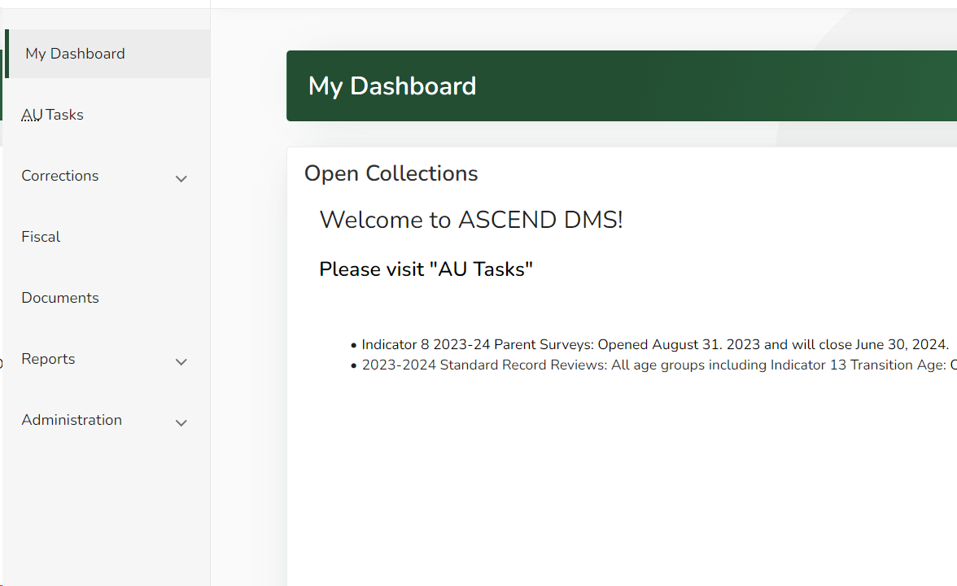
Navigating to the application
Using the sidebar navigation plane, select the fiscal option this will lead you to the Fiscal Dashboard.

Slide 8
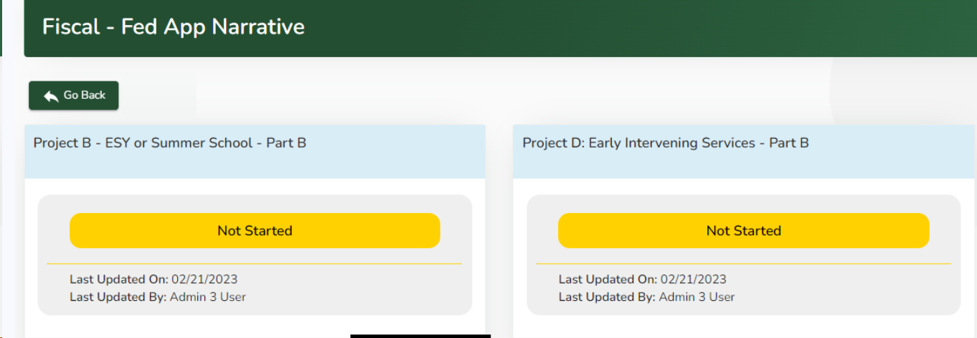
Navigating between pages in the application
To navigate between pages, use the internal GO BACK buttons. Do not use your browser navigation buttons. The Go Back buttons engage the save function in the surveys.

Slide 9
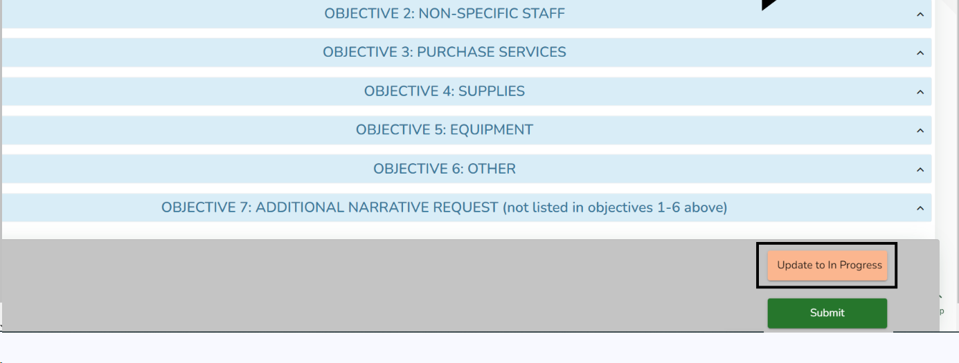
Saving your progress
When navigating between pages in order to activate the auto save function, please press the update to in progress button on the bottom right of your screen.
Always use the internal navigation options.
If you need to leave the page and return to another screen or leave the application, use the go-back button at the top left of the page.

Slide 10
Knowing what is due

Slide 11
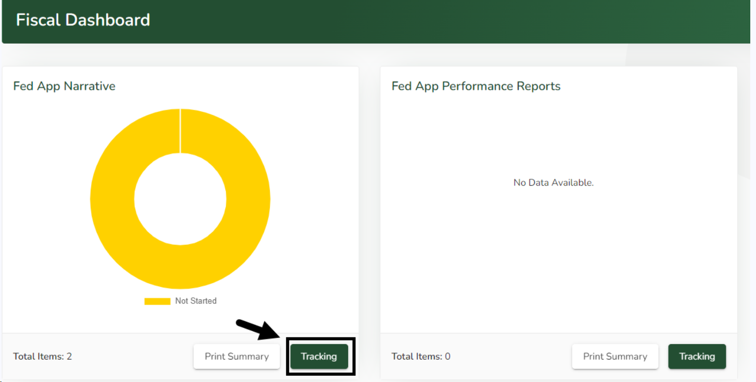
Fiscal Dashboard
The Fiscal Dashboard page will display the Fed App Narrative chart and the Fed App Performance Reports chart. Click the green Tracking button located in the bottom right corner of the Fed App Narrative chart.
If CDE has not yet assigned a Fed App Narrative, and/or Fed App Performance Report, “No Data Available” will appear in the chart.

Slide 12
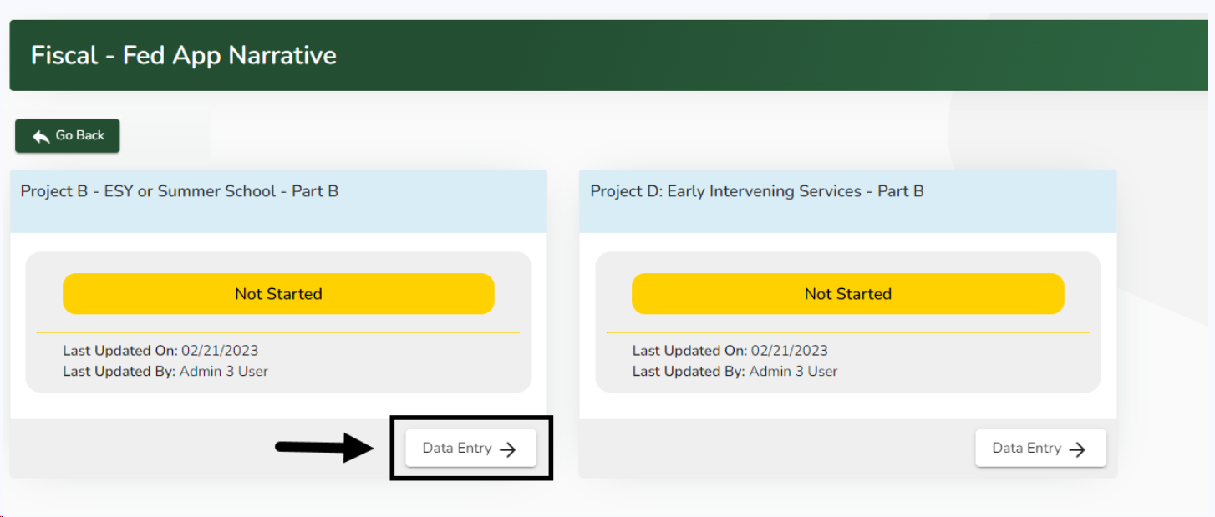
Fed App Narrative Page
The Fiscal - Fed App Narrative page will display tiles of the Fed App Narratives surveys that CDE has assigned to your AU. Click on the white Data Entry button located in the bottom right corner of the name of the Fed App Narrative that you wish to view.

Slide 13
Filling out a Project Survey

Slide 14
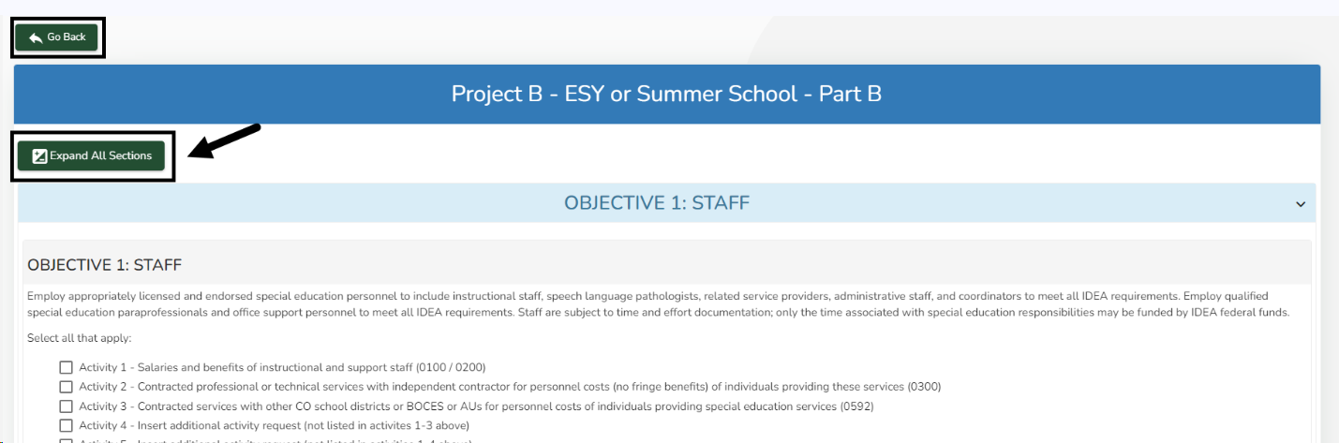
Filling out the survey
Use the green Expand All Sections and/or Collapse All Sections button in the top left corner of the survey to reveal or hide sections. You can also click a blue section header to reveal the section.
Please expand the last section on the page to reveal the Communication Summary section where you and CDE can post comments, questions, or see submission history.
If you enter some responses, but need to finish the Fed App Narrative at a later time, use the green Go Back button located in the top left corner of the page.

Slide 15
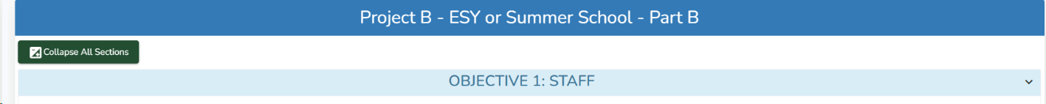
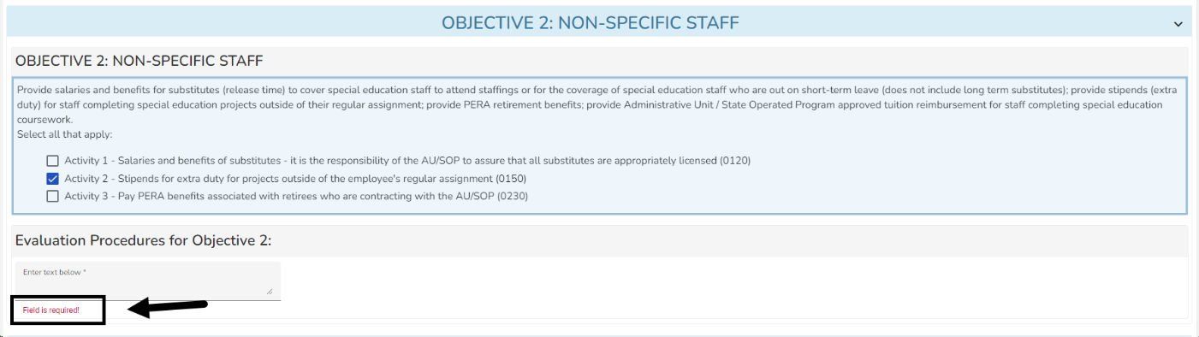
Filling out the survey (cont.)
If you want to utilize funds for an Objective you must check all the activities that you intended to utilize.
After an Activity is selected a text field for Evaluation procedures will become viewable and must be completed before you can submit the survey.
Continue through all the Objectives you will use funding for.
A red “Field is required!” text statement will appear below required fields.

Slide 16
Requirements For Survey Responses
To utilize IDEA funds the appropriate objective and activity with all required fields must be completed.
The Evaluation procedures:
  Must be related to the activity selected
  Contain 1-4 sentences describing how the AU will determine if the use of funds is contributing to the academic success of children with disabilities.
  Can not be the same for every activity
If an AU determines a need during the year or in a subsequent year to add activities that were not originally selected, this can be done during an Application Revision Window.

Slide 17
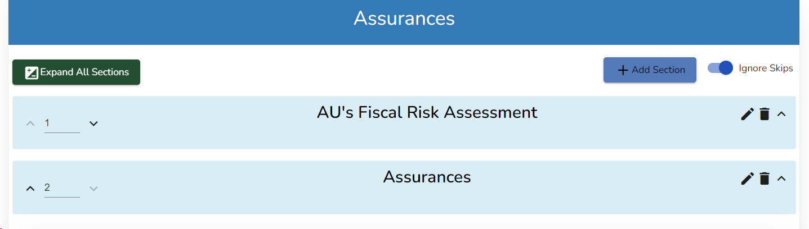
Assurances
The Fiscal Risk Assessment and the Fiscal Assurances must be completed yearly.
All sections must be filled out before you are allowed to submit the survey.
This information is required to access IDEA funds

Slide 18
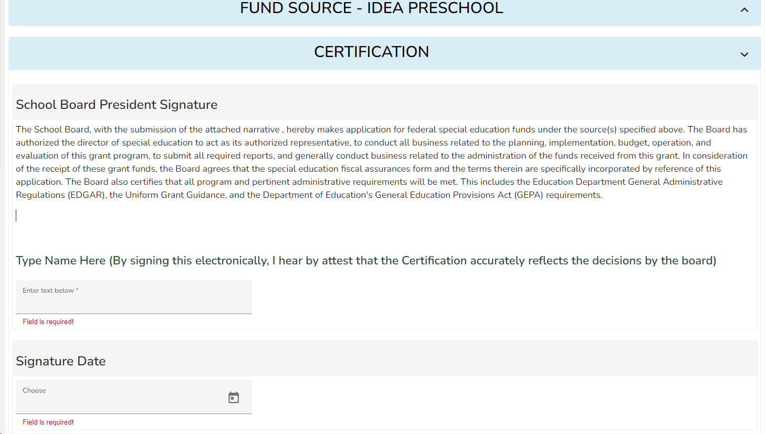
Certification

Slide 19
Certification continued
After all required Project surveys and the Fiscal Assurances are completed the AU must submit the Certification Survey.
This must be completed by the board president or an authorized representative.
This is a yearly requirement

Slide 20
Understanding the communication functions

Slide 21
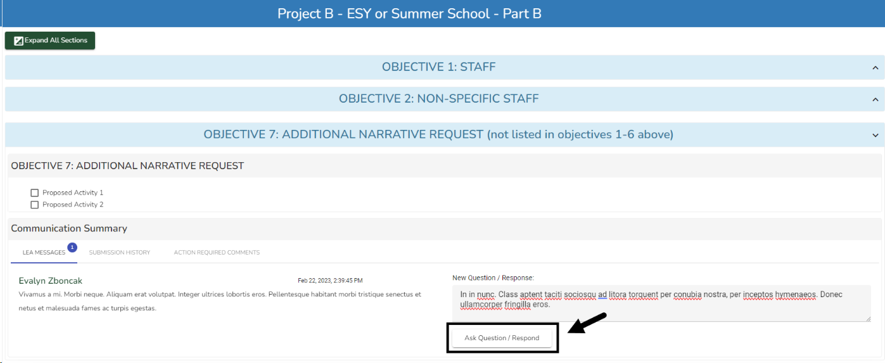
Communication Functions

Slide 22
Communication Functions continued
At the bottom of the page, in the last section on the left side of each survey, is a Communication Summary section
There are three tabs:
  LEA MESSAGES tab
    For communication between AUs and CDE
  SUBMISSION HISTORY tab
    Tracks the dates of any submissions or returns of the surveys
  ACTION REQUIRED COMMENTS tab.
Below these tabs on the right side of the page is a New Question / Response text box.

Slide 23
Submitting the Project Survey

Slide 24
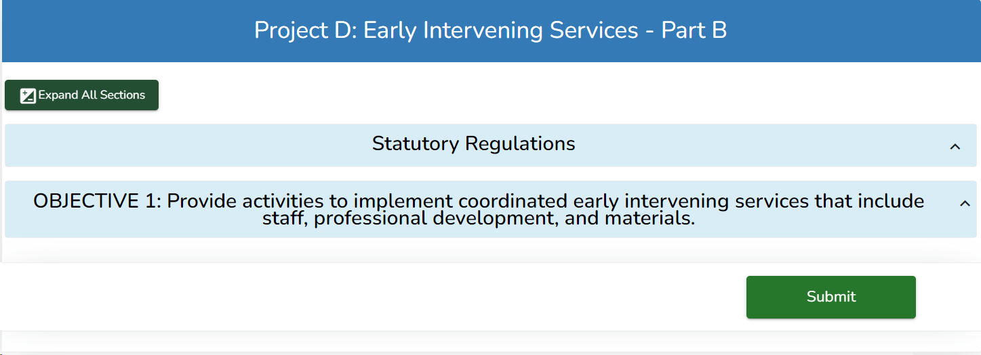
Submission
When you have completed the survey, and if you are ready to submit it to CDE, click the green Submit button located in the bottom right corner of the Fed App Narrative survey page.
The Submit button will only appear after completing all required fields.
If you are not ready to submit, click the green Go Back button at the top left corner of the page. The Submit button will only appear if all required fields have been completed.

Slide 25
Questions?

Slide 26
Contacts
Kathryn Hunt
Fiscal Monitoring Specialist
Hunt_k@cde.state.co.us
Kerry Whitmore
Supervisor General Supervision and Monitoring
Whitmore_k@cde.state.co.us

