Slide 1
Student October Duplicate Process Training 2024-2025
Brooke Wenzel StudentOctober@cde.state.co.us

Slide 2
Agenda
- Timeline
- Data Accuracy
- Overview
- Data Pipeline Duplicate Process
- Student October Submission
- Funding Allotments
- Using Syncplicity for Duplicate Count
- Required Documentation
- Considerations and Scenarios
- Contact Information

Slide 3
Timeline

Slide 4
Data Collection and Cleanup Phase Timeline
Date | Event | Event Description
07/15/2024 | Open | Districts may begin uploading Student Interchange Files (Student Demographic and Student School Association).
08/23/2024 | Open | Districts may begin creating snapshots. Student October Snapshot dependencies are the Student Demographic File, Student School Association File, Title I File (if applicable) and At-Risk File.
08/28/2024 | Training Event | Data Pipeline Training 10-11 a.m.
09/05/2024 | Training Event | New Respondent Training 1-2 p.m.
09/10/2024 | Training Event | English Language Learner Training 11-12 p.m.
09/12/2024 | Training Event | Veteran Respondent Training 11-12 p.m.
09/16/2024 | Training Event | Postsecondary Program Coding Training 11-12 p.m.
09/24/2024 | Other Date | First day of Student October Count Window for districts with 5-day school week.
10/01/2024 | Other Date | Official Count Day 2024
10/02/2024 | Interim Deadline | Upload Student Demographic and Student School Association Files. Upload Title I Interchange File (if applicable). Upload At-Risk Interchange File.
10/08/2024 | Other Date | Last day of Student October Count Window for districts with 5-day school week.
10/09/2024 | Interim Deadline | Error free Student Interchange File uploads
10/14/2024 | Training Event | Mid-Collection Office Hours 10-11 a.m.
10/14/2024 | Interim Deadline | Create an initial Student October Snapshot
10/22/2024 | Interim Deadline | Error free Student October Snapshot
10/24/2024 | Training Event | Data Validation, Transfer Enrollment Exceptions and Cognos Reports 1-2 p.m.
10/28/2024 | Training Event | Data Pipeline Duplicate Process and Submission 9-10 a.m.
11/01/2024 | Report Review | Review Student October Cognos Reports for data validation. Submit Student October Snapshot data as soon as review is complete.
11/08/2024 12:00 p.m. | State Deadline | Submit Student October Snapshot data

Slide 5
Duplicate Count Phase Timeline
Date | Event | Event Description
11/12/2024 12:00 p.m. | Deadline | Duplicate funding documentation due to School Auditing Office
11/18/2024 | Other Date | School Auditing makes decisions on funding duplicates
11/27/2024 | Deadline | Resubmit Student October Snapshot data to CDE based on decisions from School Auditing
12/06/2024 | Deadline | Collection closes Secretary of the Board of Education Verification (sign-off) form due. Data remains embargoed until the official release in January.
01/15/2025 | Data Release | Official data release
General Duplicate Count Process
Begins once all districts have submitted their Student October Snapshot to CDE, Friday, November 8th
~3 business days after running the duplicate process Duplicate Documentation is due to The CDE School Auditing Office
~2 business days after documentation received decisions will be sent to districts
Signature Page
Due Friday, December 6th: Signed by Secretary of Board of Education AND the Chief Financial Officer
If your district needs an extension, please send Student October Collection lead an email with the day when your School Board Secretary will be able to sign the form

Slide 6
Data Accuracy

Slide 7
Ensure Accurate Data
Complete the basics of the collection early (Get files error free and create snapshots by the middle of October)
An error free snapshot does not guarantee accurately reported data
Review, Review, Review!
Pull in Subject Matter Experts to assist with verifying data (Finance Department, English Learner Department, Special Education, Registrar)
COGNOS Reports for verification
How to ensure your data is accurate?

Slide 8
Some More Tips for Accurate Data Reporting
Data respondents should be coordinating with their district/LEA business officials
Prior to finalizing Student October Count data, districts should review, at a minimum, the counts that will be used to determine Total Program funding. This includes:
FTE counts by grade
Free and Reduced-Price lunch counts for all funded students
New: English language learner counts (language proficiency of NEP or LEP)

Slide 9
Overview

Slide 10
Overview
Each year Colorado public school districts and CSI participate in the Student October Count data collection.
Information submitted by districts during this data collection is used to determine each district’s Total Program funding
Funded pupil, at-risk and ELL counts
Each student has a maximum state-allowable funding level (usually 1.0 FTE)

Slide 11
Duplicate Count Process
In order to ensure no student exceeds the maximum funding level, the duplicate count process is run after all districts and CSI have submitted their Student October Snapshots
Districts will receive an email instructing them to access their Audit Exception report from Cognos if they have students appearing on their report
Districts must provide all required audit documentation to the School Auditing Office by uploading it to the district’s audit Syncplicity folder by the deadline

Slide 12
Cognos Audit Exception Report
The Cognos Audit Exception Report for each district lists students:
Who are being submitted for funding by
At least one other district
Another district and BOCES
The Audit Exception Report consists of two sections:
Summary of Pupils Being Reported by Another District: Funding Duplicates
Do submit documentation to the School Auditing Office for these students.
If you do not submit documentation, your district will automatically lose funding.
Summary of Pupils Being Reported by Another District: PAI Duplicates
Do not submit documentation to the School Auditing Office for these students.
A student listed in this section has been reported by a district/BOCES with an 01-08 Pupil Attendance Information (PAI) code and by a district/BOCES with an 01-08 code. You may want to change the student’s PAI code to 31 or 33.

Slide 13
Preparation
The turnaround time for providing duplicate count documentation is very short!
Districts and CSI are encouraged to monitor the “Summary of Pupils Being Reported by Another District” Cognos report as soon as they submit a snapshot.
This may include contacting the other district (if appropriate) and beginning to gather electronic documentation evidencing funding eligibility.

Slide 14
Duplicate Count Phase Timeline (Again)
Date | Event | Event Description
11/12/2024 12:00 p.m. | Deadline | Duplicate funding documentation due to School Auditing Office
11/18/2024 | Other Date | School Auditing makes decisions on funding duplicates
11/27/2024 | Deadline | Resubmit Student October Snapshot data to CDE based on decisions from School Auditing
12/06/2024 | Deadline | Collection closes Secretary of the Board of Education Verification (sign-off) form due. Data remains embargoed until the official release in January.
01/15/2025 | Data Release | Official data release
General Duplicate Count Process
Begins once all districts have submitted their Student October Snapshot to CDE, Friday, November 8th
~3 business days after running the duplicate process Duplicate Documentation is due to The CDE School Auditing Office
~2 business days after documentation received decisions will be sent to districts
Signature Page
Due Friday, December 6th: Signed by Secretary of Board of Education AND the Chief Financial Officer
If your district needs an extension, please send Student October Collection lead an email with the day when your School Board Secretary will be able to sign the form

Slide 15
Duplicate Count Process High-level
The School Auditing Office will review all documents for each student to determine who should submit the student for funding, and at what level.
The School Auditing Office will notify each district of its duplicate count findings.
Decisions will be uploaded to the district’s Syncplicity “Duplicate Count” subfolder.
Data Services will unlock the Snapshot for any district needing to change their data per the duplicate count findings.
Districts will then need to:
Make the appropriate adjustments to their interchange files AND
Regenerate their Student October Count Snapshot AND
Re-submit their Snapshot

Slide 16
Data Pipeline Duplicate Process

Slide 17
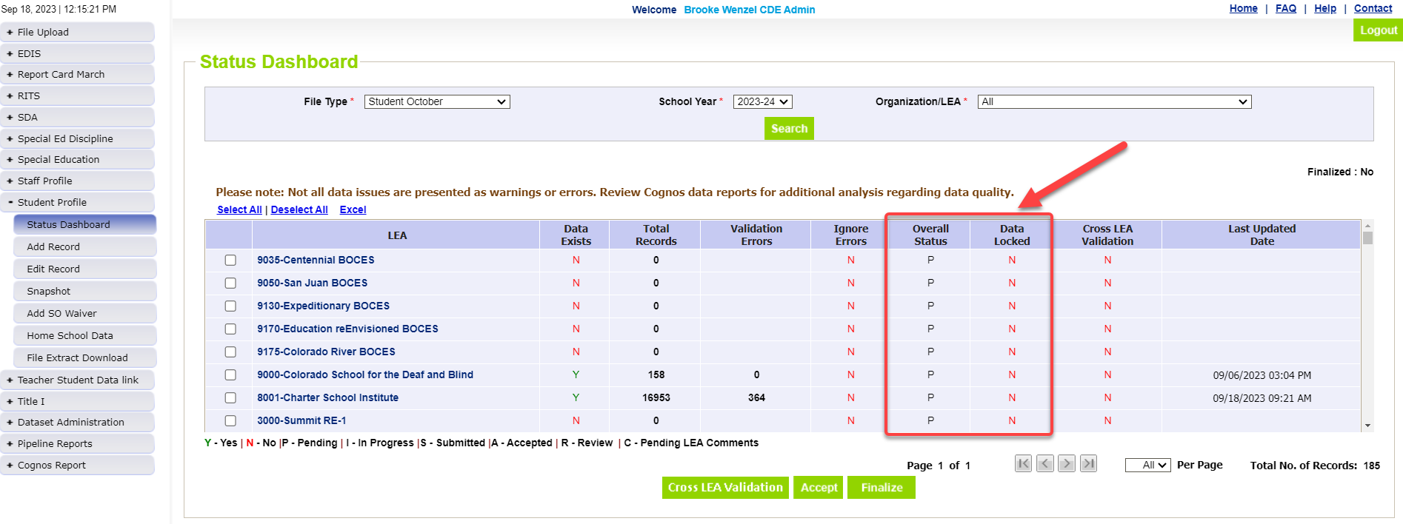
Waiting for all Districts to Submit
All districts must have Overall Status = ‘S’ and Data Locked = ‘N’
Submitting your data will change these flags in the system

Slide 18
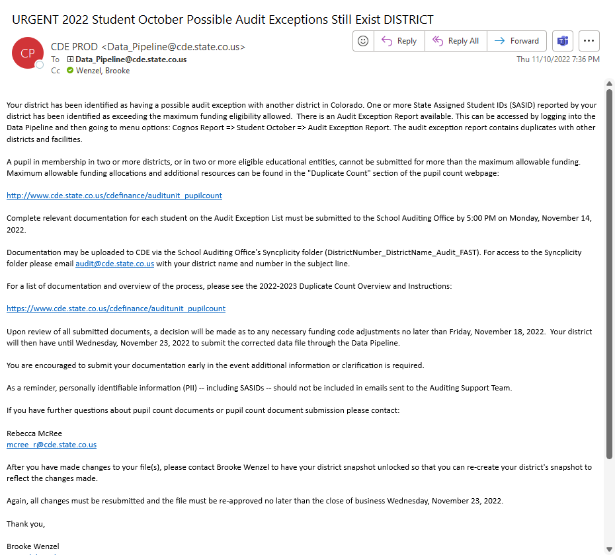
Run Cross LEA – Email is sent upon completion
- You will receive an “URGENT” Email if one or more students are pulled into the Duplicate Phase.
- Instructions are within the email (last year’s email shown on the left)
- Don’t receive the email? Double check Audit Exception Report CEDAR Report (next slide)

Slide 19
Audit Exception Report (under Student October Reports)
Summary of pupils being reported by another district: Funding Duplicates*
Summary of pupils being reported by another district: PAI Duplicates
Will not populate until after Cross LEA has been run
The information that your district is reporting is always Organization A (red) and will display students that are being submitted by at least one other district and whose total funding exceeds the state’s maximum allowable level.

Slide 20
Student October Submission to CDE (for the second time)

Slide 21
Update Data/Ready to Submit
Make changes to Student Interchange Files, Take a New Snapshot, Verify Data
Submit the snapshot to CDE
Student Profile -> Status Dashboard and click ‘Submit to CDE’
Must have OCT~LEAAPPROVER role in IDM to complete this step

Slide 22
Funding Allotments

Slide 23
Total Funding Allotment Acceptable Codes
Edit checks are in place to ensure that a given district does not submit an individual student for a funding level that is not allowed, per statute
Full-time funding (1.0 FTE) | 80, 91 and 92
Part-time funding (0.5 FTE) | 82, 85, 94 and 95
No funding (0.0 FTE) | 86, 87, and 96

Slide 24
Total Funding Allotment
In general, the following rules apply:
Students in grades K-12 cannot exceed a total of 1.0 FTE
Home-school and private school students (regardless of grade level) cannot exceed a total of 0.5 FTE

Slide 25
Edit Checks
The following criteria/edit checks will result in a student being included in the Duplicate Count process:​
Students in any grade level who are submitted for more than a total of 1.0 FTE​
Home-school and private school students who are submitted for more than a total of 0.5 FTE ​
Home-Based Education Flag value of “1”, and/or Funding code of “85”​
If a district submits a student with a funding code of "86" and home-based education flag of "1", that district does not have to upload documentation. However, the district submitting the student for funding does have to upload documentation.​

Slide 26
Edit Checks Continued
The following students will also be included in the Duplicate Count process:​
Students who are submitted for 0.5 FTE in more than one district​
This will allow the School Auditing Office to verify the students aren’t home-school or private school students.​
This may or may not result in funding changes.​

Slide 27
Using Syncplicity for Duplicate Count

Slide 28
Audit Syncplicity Folder
An audit Syncplicity folder has been created for each district and CSI
The naming convention for these Syncplicity folders is as follows:
District Number_District Name_Audit_FAST
For example: 0010_Mapleton 1_Audit_FAST

Slide 29
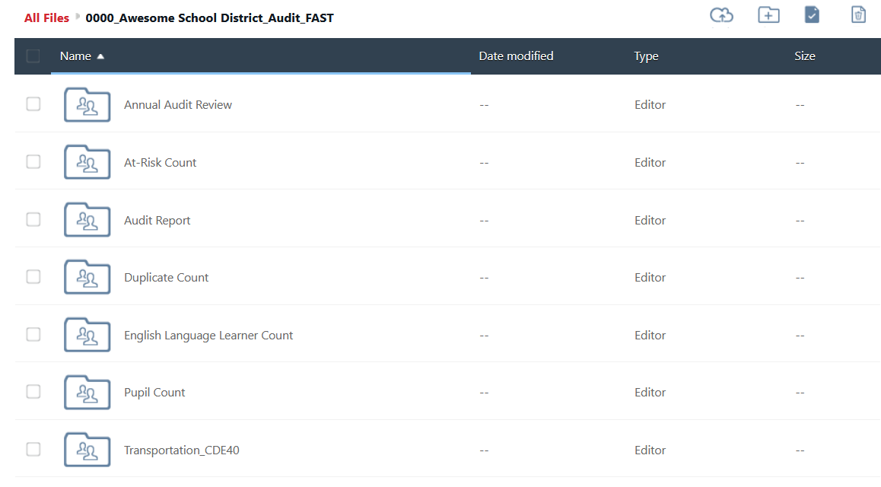
Audit Syncplicity Folder Structure
Do not change or delete these folders!

Slide 30
Audit Syncplicity Folder – Uploading Documents
All duplicate count audit documentation must be uploaded to the “Duplicate Count” subfolder found within the district’s audit Syncplicity folder.
Document Upload Deadline: Tuesday, November 12, 2024 at 12 pm
Uploading sooner benefits everyone!!!!!!!!!!!!!!!!!!
Data Services will send out an email if this deadline is adjusted for any reason.
Check whether you have access to your district’s audit Syncplicity folder!​
If not, email the School Auditing Office at audit@cde.state.co.us​
In the subject line of the email, please include your district number, district name and “Duplicate Count Contact”​
For example: “0010_Mapleton 1_Duplicate Count Contact”

Slide 31
Required Documentation

Slide 32
Duplicate Count Documentation
Districts will need to upload all required audit documentation to the “Duplicate Count” subfolder for all students included on the “Audit Exception Report” (except students with an “86” funding code)
This includes both:
School- or district-level documentation
Student-level documentation

Slide 33
Documentation: School- or district-level
These documents describe programs and services, and provide context for interpreting student schedules and attendance, and allow for bell schedule calculations
District/school/program calendar
District/school/program bell schedule (or equivalency)
District/school/program handbook & course catalog (for secondary and district-run programs, including home school enrichment programs)
Online Schools and Programs- Authorizer Assurances
Δ Link to Catalog of Courses using Alternative Instruction, if applicable

Slide 34
Documentation: Student-level
Upload documentation to the “Duplicate Count” subfolder for all students included on the “Audit Exception Report.” ​
The level of detail required for student-level documentation during Duplicate Count may exceed what is required for normal auditing purposes. ​
The School Auditing Office must sometimes make funding determinations between districts with very similar documentation and grounds for funding, so be prepared to upload an expanded body of documents for contested students. ​
Whenever possible, include additional proof of attendance and participation in courses, especially for students receiving instruction off-site through digital means and/or sparse attendance

Slide 35
Documentation: Student-level Continued
Household demographic printout (from SIS)
Full enrollment history (with the district)
Student schedule (regardless of grade level) for all of Fall semester
Semester 1, Quarters 1 & 2, Hexters 1, 2 & 3, etc.
Δ Identify which courses are alternative instruction courses, if applicable
Additional documentation as applicable
i.e., corresponding unique student/course/school/program type documentation outlined in the 2024 Student October Count Audit Resource Guide
A short narrative may be useful to provide context regarding unique student circumstances not made clear by other documentation
Attendance verification (additional considerations on next slides)

Slide 36
Documentation: Student-Level Attendance Verification
Expanded Attendance verification ​
Include attendance for the entire months of September AND October (not just the count window).​
Attendance reports generated out of student information systems (SIS) can be used to verify direct in-person or synchronous learning.​
SIS reports alone will not be sufficient to evidence attendance for off-site/alternative instruction courses
Documentation must include course-level attendance.
Documentation must evidence actual off-site participation/attendance.
Online attendance must be documented per district, school, or program policies and/or Authorizer Assurances.

Slide 37
Δ Documentation: Alternative Instruction Course Attendance
The only acceptable forms of documentation evidencing attendance for alternative instruction courses are:
Evidence of attendance in direct instruction content
Logins into course content for digitally-delivered instruction
For work-based learning courses, documentation from an employer (e.g., timesheets, paystubs, etc.) that lists a student’s name and dates worked
For Independent Study courses, districts would have had to submit a request for alternative attendance documentation by September 15 (only 1 district made this request)
Note: Review the student's schedule before deciding what attendance documentation to provide.

Slide 38
Documentation: Online School and Program Attendance
For online school and program attendance, school or program policies and/or Authorizer Assurances determine appropriate documentation
Provide documentation evidencing actual off-site participation/attendance, generally at the course level
For duplicate count purposes, evidence of participation in multiple courses is encouraged
Provide multiple types of documents, if available, to show the best possible evidence of student engagement during the semester
Include September AND October, but be especially thorough for the 11-day count window
If policy or Authorizer Assurances allow, examples of attendance documentation may include, but are not limited to:
course log-ins
gradebooks showing dates assignments/tests were completed and submitted
dated progress reports
scanned assignments with name and date
etc.

Slide 39
Documentation: Labeling
For each student, please upload one assembled document using the following naming convention:
District Number_SASID_Student Last Name_Student First Name
For example: 0010_9999999991_Smith_John.pdf
Each assembled document should contain all required audit documents necessary to support funding.
If necessary, a single folder or zip file for each student may be used.

Slide 40
Documentation for Conceded Students
If your district is conceding funding for a student (i.e., your district submitted the student for funding in error), you must still upload a document for the student, with the following naming convention:
District Number_SASID_Student Last Name_Student First Name_Concede
For example: 0010_9999999991_Smith_Jane_Concede.pdf
This document can be blank.

Slide 41
Considerations and Scenarios

Slide 42
General Principles
Under most circumstances, the following general principles are considered in combination with the total picture provided by the supporting documentation:
A district using the official count date takes precedence over a district using an alternative count date
A district providing a full-time program of services to a student takes precedence over a district providing a part-time program of services
If a student meets the attendance criteria on the count date at multiple districts (which use the same count date), the receiving district generally takes precedence
Home-school and private school students may only be funded in a single district (funding cannot be split)
For these students, the district of residence generally takes precedence over other districts

Slide 43
Scenarios and Considerations
The following slides cover some common scenarios that frequently arise during the duplicate count.
The specific circumstances surrounding a given scenario will determine funding decisions.
Districts are encouraged to upload an expanded body of documents for contested students.

Slide 44
Alternate Count Date Scenarios

Slide 45
Alternate Count Dates
In the event a student meets the funding criteria at multiple districts, and each district is using a different count date, the following is the general count date “hierarchy” that is used to determine which district is eligible to submit the student for funding:
Scenarios higher on the list take precedence.
Student who meets the requirement on count day:
At a district using the official pupil enrollment count date (10/1)
At a district using an approved alternative count date (either before or after the official pupil enrollment count date)
Student who transfers in and meets the requirements during the 11-day count window:
To a district using the official pupil enrollment count date
To a district using the approved alternative count date
Whenever possible, districts should try to resolve duplicate count issues related to count date/enrollment prior to the duplicate count process.

Slide 46
Official Count Date Takes Precedence
Districts using the pupil enrollment count date (10/1) will always have precedence over those that are using an alternative count date
This is true whether the alternative count date comes before or after the pupil enrollment count date
Example:
District A used the pupil enrollment count date of 10/1
District B used an alternative count date of 10/6
The student met the funding requirement at District A before transferring to District B on 10/4 and meeting requirements there.
District A is allowed to count the student for funding.

Slide 47
Two Districts with Approved Alternative Count Dates
If a student meets all funding requirements at two different districts which both had an approved alternative count date:
Example:
District A had an approved alternative count date of 9/22.
District B had an approved alternative count date of 10/6.
Student was enrolled at District A until 9/27, then the student transferred to District B and began attending on 9/29.
The receiving district is eligible to include the student for funding.
Even though funding criteria were met at both districts, District B (the receiving district) is allowed to submit the student for funding

Slide 48
Simultaneous Enrollment Scenarios

Slide 49
Students Enrolled in both a Full-Time and a Part-Time School/Program
If a student is enrolled in both a full-time Colorado public school or program and a part-time program in another Colorado district
AND the student meets schedule and attendance requirements in both districts
AND the student continues to be participating in both at least through the last day of the 11-day count window
When in doubt, both districts are encouraged to submit audit documentation during the duplicate count.
The full-time school or program is eligible to submit the student for full-time funding.
The part-time enrollment will not receive any funding.

Slide 50
Students Enrolled Full-Time at a Colorado public Online School or Program and Part-Time at a Brick-and-Mortar School
If an online school or program is providing a full-time educational program and a brick-and-mortar school is providing a part-time program:
Note: The district of residence is not obligated to provide supplemental educational opportunities to a student enrolled full-time in a Colorado public online school or program
Brick-and-mortar schools may consider requiring tuition for these students
Such decisions are left up to each individual district
When in doubt, both districts are encouraged to submit audit documentation during the duplicate count.
The full-time (online) school or program is eligible to submit the student for full-time funding.
The part-time (brick-and-mortar) enrollment will not receive any funding.

Slide 51
Student being reported as part-time at two different districts but not reported as home-school
If two districts are reporting a student for part-time funding and neither district has indicated the student is a home-based education student:
If the duplicate count document review shows the student IS a home-based education (or private school) student:
If the duplicate count document review shows the student IS NOT a home-based education (or private school) student:
Generally, if a student is receiving educational services by multiple districts, one of those districts has taken on the primary responsibility for the student’s education (i.e., the district from which the student would graduate).​
The district primarily responsible for the student’s education will usually have a contractual agreement with the secondary district to provide services.​
The student will be treated as a home-based education student enrolled in two districts (as discussed later in the presentation)
Neither district will be asked to change the reported funding code.

Slide 52
Transfer Scenarios

Slide 53
Transferring On the Pupil Enrollment Count Date
If a transferring student meets the attendance criteria on the count date at multiple districts (who are all using the same count date):
Example:
Student was enrolled and attended at District A for the last time in the morning on the pupil enrollment count date (10/1)
The student then transferred to District B and attended in the afternoon on the pupil enrollment count date (10/1)
The receiving district is generally eligible to submit the student for funding.
Even though the student met all funding criteria at both schools on the pupil enrollment count date, District B (the receiving district) is eligible to submit the student for funding

Slide 54
Students Transferring Within-State into a District After the Pupil Enrollment Count Date
If a student transfers from one Colorado public school district to another after the pupil enrollment count date but during the 11-day count period:
If the student met the funding criteria at the sending district:
If the student did NOT meet the funding criteria at the sending district:
Example:
Student was enrolled and attended at District A for the last time in September (prior to the pupil enrollment count date)
The student then transferred to District B and attended on 10/4, after the pupil enrollment count date (10/1)
For additional information please refer to the “Transfer Student (Enrollment Exceptions)” section of the Student October Count Audit Resource Guide.
The sending school district is generally eligible to submit the student for funding
The receiving district is generally eligible to submit the student for funding
District B is eligible to submit the student for funding

Slide 55
Transferring Around the Pupil Enrollment Count Date
If a student meets the attendance criteria on the count date at multiple districts (using the same count date):
Example:
Student was enrolled and attended at both District A and District B during the count window before/on and after 10/1 (count day)
In this example, both districts have the same 11-day count window
Student stopped attending District A on 10/4, after count day
The student continued attending District B at least through 10/8 (the last day of the 11-day count window)
Note: This is most likely to occur with students scheduled into alternative instruction courses and/or online schools and programs.
The receiving district is generally eligible to submit the student for funding
Even though the student met all funding criteria at both schools on the pupil enrollment count date, District B (the receiving district) is eligible to submit the student for funding

Slide 56
Home-school & Private School Scenarios

Slide 57
Home-school (and Private School) Students Enrolled Simultaneously in Multiple Districts
Home-school (and private school) students are eligible for a maximum of 0.5 FTE, meaning funding cannot be split for these students.
If a home-school student is participating in two part-time programs simultaneously at two different districts, and both districts are using the same count date:
If neither district is the district of residence, or if it is not clear which district is the district of residence:
The district of primary residence will receive (part-time) funding
Both districts should submit documentation for consideration during the duplicate count process, as additional information (such as history of enrollment with each district) will be considered

Slide 58
Non-Funded Home-school Students Enrolled Full-Time at Another District
If a student is participating in a full-time program at one district, and another district has reported them as a non-funded (i.e., funding code '86') home-school student:
The district claiming the student for funding must upload documentation showing the student is eligible for full-time funding
The district who flagged the student as home-school (funding code '86') is not required to upload anything
Depending on the results of the full-time district’s documentation, may be required to remove the home-based education flag from their snapshot

Slide 59
Districts are strongly encouraged to work collaboratively to determine which district should submit each student for funding before the deadline for submitting duplicate count documents. If districts cannot come to a resolution regarding who is eligible to submit the student for funding, then both districts should submit their expanded body of documentation for funding consideration.

Slide 60
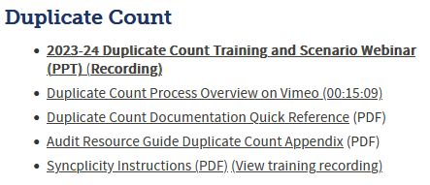
School Auditing Office- Duplicate Count Resources
Pupil Count Webpage Link
The pre-recorded Duplicate Process Overview Video is about 15 minutes long and includes valuable context.

Slide 61
Contact Information
School Auditing Office
audit@cde.state.co.us
Rebecca McRee
mcree_r@cde.state.co.us
303-482-6286
Brooke Wenzel StudentOctober@cde.state.co.us 720-441-7963
Auditing Office Training Schedule
Auditing Office’s Pupil Count Website
Data Pipeline Town Halls
Identity Management/Data Pipeline Student Interchange Website
Student October Website
Syncplicity

