Slide 1
CDE Office Hours
April 25, 2024
Notes:
DeLilah

Slide 2
Updates and Reminders
Nazie Mohajeri-Nelson
Fiscal Year 2024-2025 allocations
  Phone calls
  Posting CDE’s Grants Fiscal Allocations Website and ESSA Allocations Website
ARP ESSER III
  PARs = June 30, 2024
  Request Funds
Bill Parsley
Fiscal monitoring update
  Timely submittal of evidence
  Requests for payments
Notes:
DeLilah

Slide 3

2024-2025 Consolidated Application System Training
Notes:
DeLilah

Slide 4
Agenda
Welcome to the ESEA Consolidated Application in GAINS
Upcoming Due Dates and Reminders for Submissions
How to Access GAINS
  Locating the ESEA Consolidated Application
Overview of the Consolidated Application
Consolidated Application Walkthrough
BOCES Training
Additional Support
Questions
Notes:
DeLilah

Slide 5
Welcome to the 24-25 Consolidated Application
The Consolidated Application will be collected in the new Grant Administration Implementation and Navigation System (GAINS) online application. GAINS is a role-based system, and users must have a role to apply for funding.
The Consolidated Application will now be collected in two parts in GAINS:
  ESEA Acceptance, Relinquishment, Assignment, and Certification (ARAC) (Application Supplement): This collects -
    The Assignment of Funds (Accept, Decline, Assign To),
    The Retention of Funds Form (if applicable),
    The Tribal Consultation Attestation (if applicable),
    General Assurances
    Approval and Transmittal Certification
  ESEA Consolidated Application (Funding Application): This collects -
    The Non-Public School Consultation Form (if applicable),
    Program Narratives
    Program Budgets

Slide 6
Due Dates and Reminders

Slide 7
Timeline: Substantial Approval
In order to receive Substantial Approval on the 2024-2025 Consolidated Application, the applicant will need to submit the following:
Activity | Due Date | Submission Location
School Improvement Retention of Funds Form | ASAP | ESEA ARAC: School Improvement Retention of Funds page
Approval and Transmittal Certification/General Assurances | ASAP | ESEA ARAC: FY 2024-2025 Consolidated Application for ESEA Program Funds Approval and Transmittal
BOCES Member District ARAC Form | May 24 | BOCES ESEA ARAC: FY 2024-2025 Consolidated Application for ESEA Program Funds Approval and Transmittal
Non-Public School Consultation Forms | June 30 | ESEA Consolidated: Non-Public Schools page
Native American Education Tribal Consultation Form | June 30 | Submit form to Georgina Owen and complete Attestation in GAINS
Online Application | June 30 | http://colorado.egrantsmanagement.com
Notes:
Tribal Consultation form must be submitted to Georgina Owen – owen_g@cde.state.co.us

Slide 8
Extension Requests
If the LEA/BOCES is unable to submit all the requirements for Substantial Approval by June 30 the LEA or BOCES may request an extension by submitting a completed extension request form through the GAINS platform.
The LEA/BOCES may not encumber funds until a complete application has been submitted to CDE and granted Substantial Approval. Once the extension request has been submitted and approved, the LEA/BOCES has until the last business day in July to submit requirements for Substantial Approval.

Slide 9
GAINS Access

Slide 10
Consolidated Application & GAINS
The Consolidated Application is now in the Grant Administration Implementation and Navigation System (GAINS)
To access GAINS, you will need to communicate with your Local Access Manager or LAM to ensure you have the right roles and permissions for the Consolidated Application.
  If they have any trouble adding you as a user or assigning your role, please let us know either by emailing GAINS@cde.state.co.us or filling out a Help Desk Ticket.
  Unsure of your role? Log into GAINS and navigate to the Address Book in the navigation bar on the left side of the screen.

Slide 11
What Roles Are Needed to Access the Consolidated Application, ARAC and Extension Request?
ESEA Consolidated Application Roles for LEAs and BOCES
  LEA ESEA Consolidated Director
  LEA ESEA Consolidated Update (update role can only edit, cannot start or complete the application)
ESEA ARAC Roles
  LEA ESEA ARAC Director
  LEA ESEA ARAC Update (update role can only edit, cannot start or complete the application)
  BOCES ARAC Roles
  LEA BOCES ESEA ARAC Director
  LEA BOCES ESEA ARAC Update (update role can only edit, cannot start or complete the application)
Extension Request Roles
  LEA ESEA Consolidated Application Extension Director
  LEA ESEA Consolidated Application Extension Update (update role can only edit, cannot start or complete the application)
Note: LEA Fiscal Representative can start all items above. LEA Authorized Representative can take all actions needed to start and fully submit for all applications and supplements listed above.

Slide 12
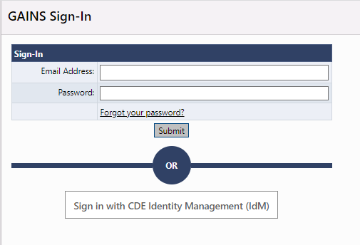
Online Application – IdM Users
Find the login button on the top right of your screen. Login to the GAINS through the Identity Management System:
Notes:
Kim

Slide 13
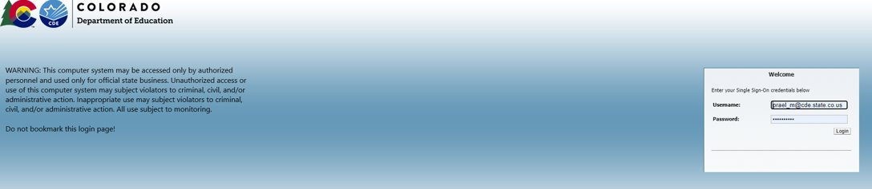
Logging In – IdM Users
The next page you will see is where you enter your Single Sign-on credentials. The username will be your full email and the password will align to other CDE logins.
If your login doesn't work – STOP! Contact your district Local Access Manager (LAM) to make sure you have access to the Identity Management System (IdM).

Slide 14
Navigating to the ESEA Consolidated

Slide 15
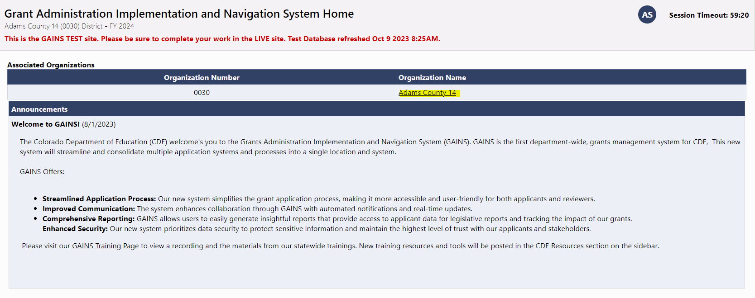
Navigate to Funding Applications
Step 1: Once logged in, select your Organization's name:

Slide 16
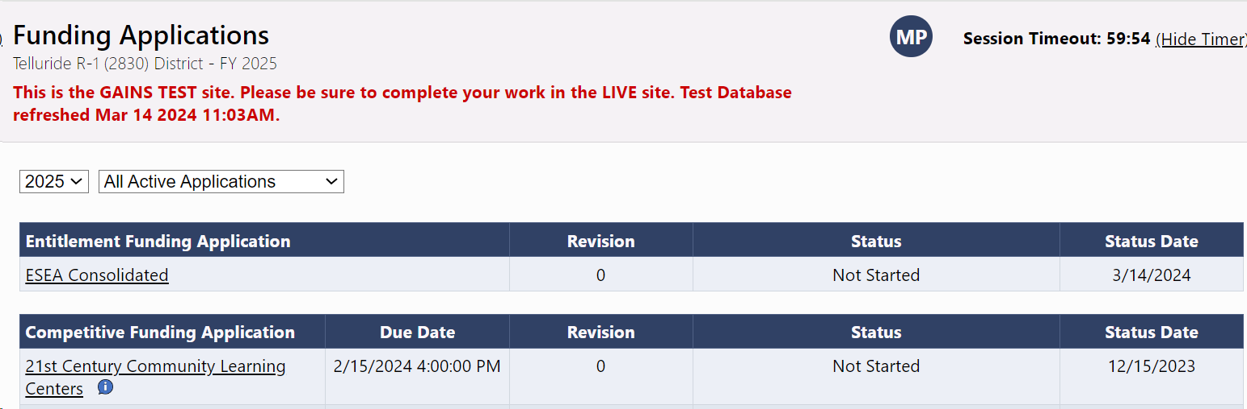
Find the ESEA Consolidated
Step 2: Select “ESEA Consolidated”

Slide 17
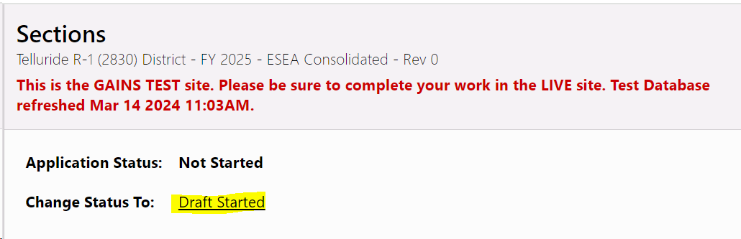
Begin your Application
Step 3: Begin your application and be sure to change your application status from "Not Started" to "Draft Started."

Slide 18
Consolidated Application: Application Navigation

Slide 19
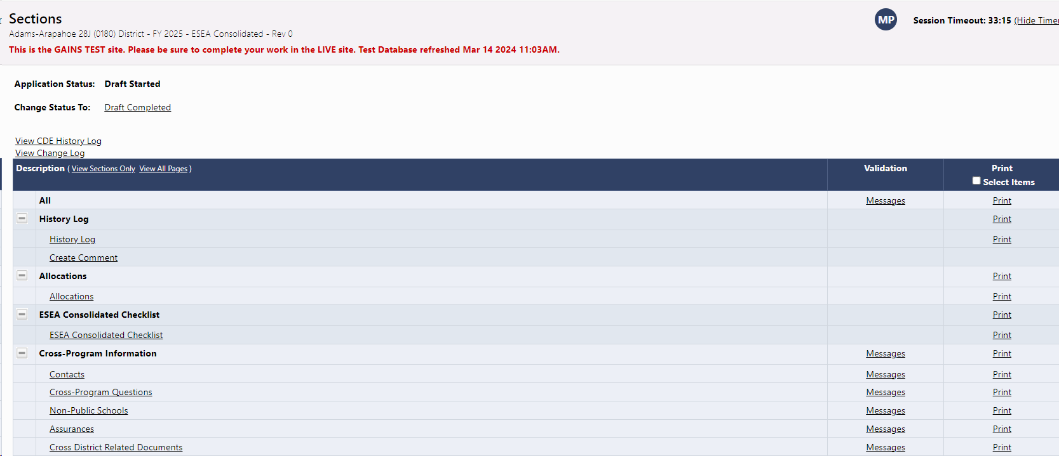
Application Navigation
Once in the Consolidated Application, you’ll be taken to the Sections Page.
The Sections Page is common to ALL grants in GAINS.
Here you can change the status of an application; view the History Log, Comments, and Change Log.
Depending on your permission level, users can view and/or edit the grant application and associated sections.
You can also print the application in full or in part.
In the validation column, “Messages” indicate warnings or errors present in the current version of the application.

Slide 20

Different Statuses
An application can display several different statuses:
Not Started - indicates that the application has not been opened by the applicant and it is not editable.
Draft Started / Revision Started – the application is open for edits.
Draft Completed / Revision Completed – the application is awaiting approval from the LEA Fiscal Representative.
LEA Fiscal Representative Approved – the application is awaiting approval from the LEA Authorized Representative.
LEA Authorized Representative Approved – the application has been submitted to CDE and enters the review workflow.
  LEA Fiscal Representative or LEA Authorized Representative Returned – the application requires revision and is once again open for edits. After edits are completed, the approval workflow begins again.
SEA ESEA Consolidated Consultant Approved – the application is awaiting approval from the assigned CDE Director.
SEA ESEA Consolidated Director Approved – the application has received final approval from CDE.
  SEA Consultant or SEA Director Returned – the application requires revision and is reopened for the applicant to make changes.

Slide 21
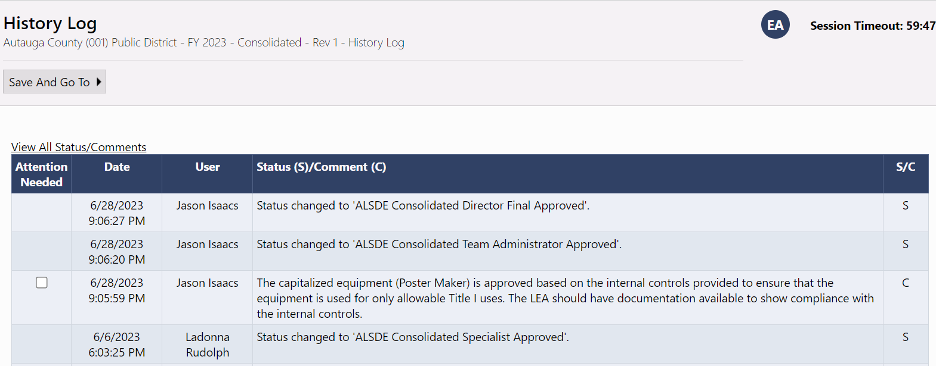
History Log
Also, on the Sections Page, users can access the History Log. The History Log lists all status changes and comments related to the application, including details on who made the change and when.

Slide 22
Comments
Comments are ongoing notes and discussion between your organization and CDE related to a funding application.
Comments can be made by anyone with access to the application at any time, regardless of the application’s status.
Comments can be emailed to intended recipients if you’d like to distribute a comment outside of the system.
Comments are saved within the funding application and can be referenced at any point. They will remain a part of the permanent record for the application.
Comments are not visible to public users.

Slide 23
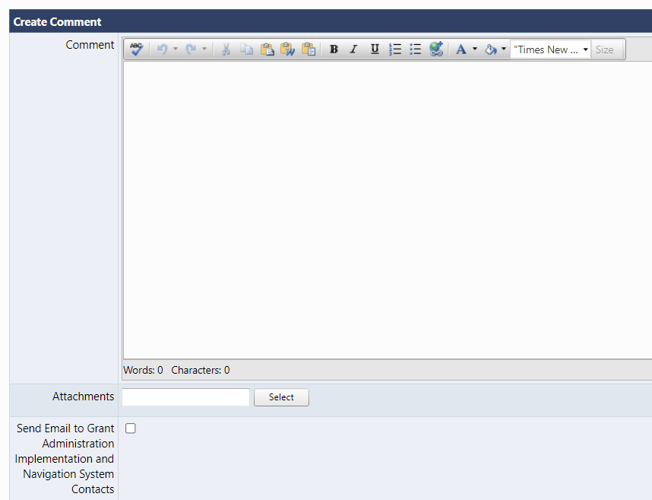
View of Comments
When you select “Create Comment” on the Sections Page, you’ll be taken to this screen.
Compose your message.
Provide any attachments (optional).
If you like to send this comment in an e-mail as well, you can select the applicable contacts after checking the “Send Email” box.

Slide 24
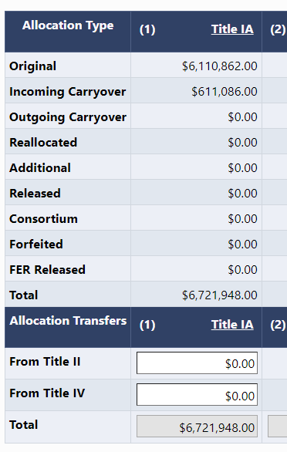
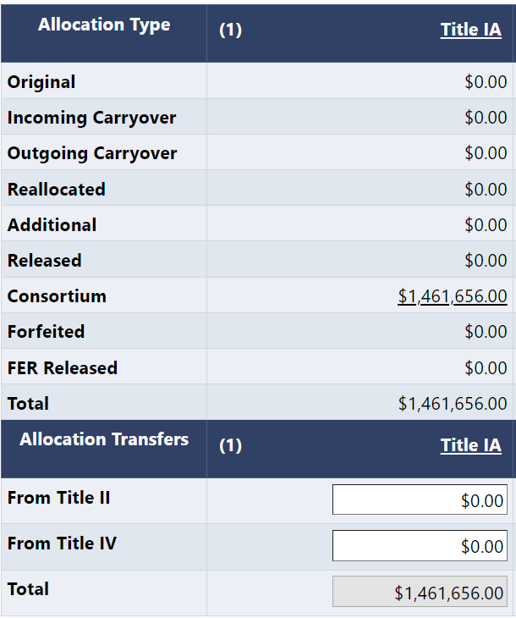
Allocations Page
The Allocations page displays the funds that were accepted by the LEA and/or transferred to the BOCES from the LEA. Note: Not all items will contain an amount, and some may never be used.
Original – Amount allocated to LEA for the program listed
Incoming Carryover – amount of unspent funds being brought forward from the previous year
Outgoing carryover – Carryover funds being distributed to another program
Reallocated – funds that were reallocated to the LEA from previously unspent funds
Additional – additional allocation provided to the district
Released – declined funds or funds the district opted not to use
Consortium – amount assigned to the BOCES from LEAs
Forfeited – funds pulled from the LEA by the SEA
Final Expenditure Report (FER) Released – funds that were not spent and will not be carried over.
Use editable cells to transfer funds

Slide 25
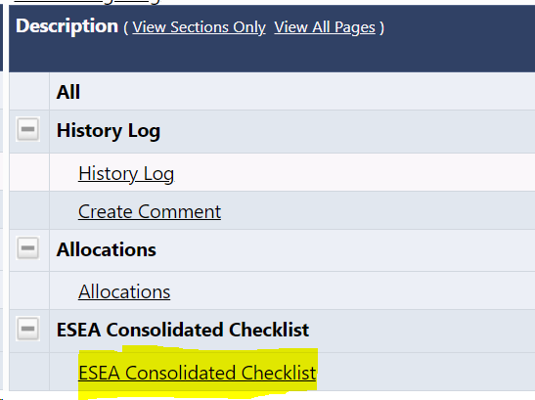
ESEA Consultant Checklist
Review comments will be captured in the ESEA Consultant Checklist.
This can be found on the Sections page.
This checklist will contain the reviewer's criteria for each aspect of the application.

Slide 26
Application Information
Consolidated Federal Programs Application Overview
Provides an overview of ESSA
Criteria for Substantial Approval
Links to supports and resources found on the FPSU website
NOTE: This page is informational only.

Slide 27
Consolidated Application: Narrative Questions
Notes:
PG

Slide 28
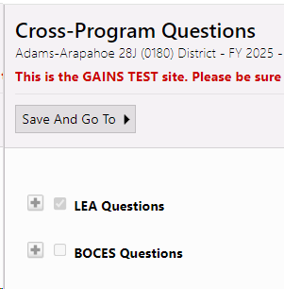
Narrative Question Layout
Each narrative section has a set of questions for LEAs and a set of questions for BOCES.
These sections will be pre-selected based on your organization and expanded so questions can be seen, and responses can be entered.
Notes:
PG

Slide 29
Narrative Question Logic
Not all questions in the narrative sections are applicable to each organization.
  Title I, Part A Question 5: Only for LEAs with neglected facilities.
  Title I, Part A EDT Section of Questions: Only for LEAs with Medium and/or Large Size Gaps.
  Title I, Part A – Targeted Support and Improvement Section: Only for LEAs with schools identified for Targeted Support and Improvement (TS) and Additional Targeted Support and Improvement (ATS).
  Title II, Part A Question 2: Only for LEAs with schools identified for Comprehensive Support and Improvement (CS), Targeted Support and Improvement (TS) and Additional Targeted Support and Improvement (ATS).
Notes:
PG

Slide 30
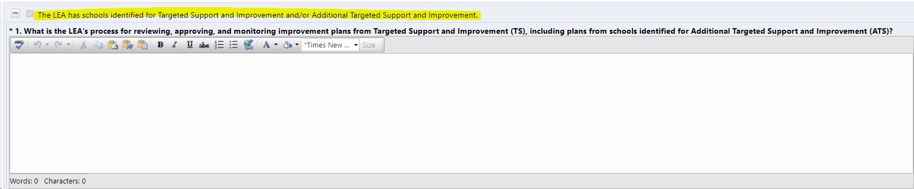

Narrative Question Logic Continued
The application will automatically check these questions or sections if your LEA meets the criteria. Users will be unable to uncheck the box.
  When the box is checked, all the questions associated will appear.
If the LEA doesn't meet the criteria, the box will not be checked. Users will be unable to check the box.
  However, LEAs can use the plus symbol to see the questions but won't be able to respond to the questions.
Notes:
JH last slide

Slide 31
Consolidated Application: Non-Public Schools Page
Notes:
DC

Slide 32
Non-Public Schools
This page can only be completed by LEAs with non-public schools.
  It will list all known Non-Public Schools.
  It includes additional fields that users will need to address, including:
    Total Number of Students in the District
    Number of English Learners Attending a Public School
    Total Enrollment per Non-Public School
  These additional fields will allow the application to calculate the allocation for Equitable Services for Title II, Title III, and Title IV.
The non-public school page will still calculate the proportionate share for Title I like normal.
  The only change is that the "#of low-income students residing in a Title I school boundary and attending a non-public school" is required for all eligible schools.
Notes:
DC

Slide 33
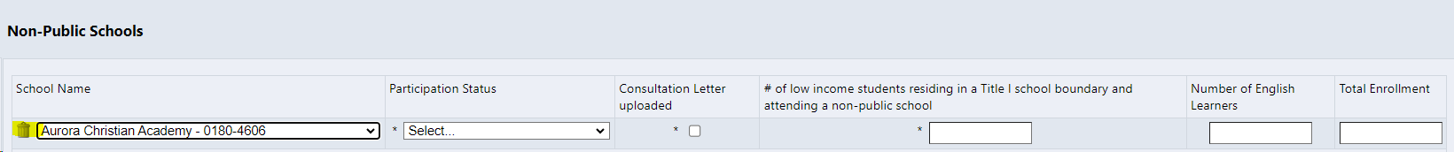
Non-Public Schools Reminder
All eligible non-public schools will need a Non-Public School Consultation form uploaded into the platform. This is regardless of whether the school decides to participate or not in funding.
If the school is not eligible for funding like a for-profit school or a daycare, users can use the trash can to remove the school from the list.
Notes:
DC

Slide 34
Consolidated Application: LEA Set-Asides
Notes:
DC

Slide 35
LEA Set-Asides
The biggest shift in the new platform is how Title I functions compared to the previous applications.
In the previous applications, LEAs and BOCES would complete the budgets first before reviewing PPA and rank order.
The LEA Set-Asides page in GAINS is reversing the process. GAINS will use the LEA Set-Asides page to determine the allocation for schools.
This page must be completed prior to the School Ranking (School Profile) page and budgeting!
Notes:
DC

Slide 36
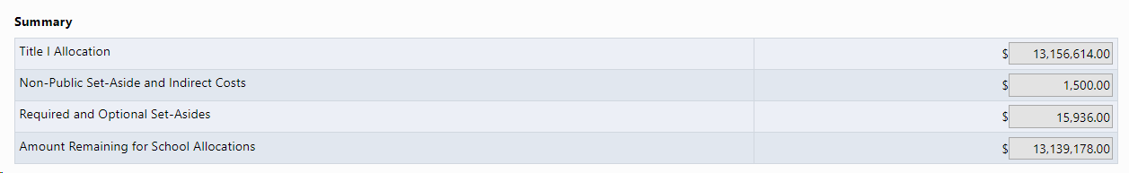
LEA Set-Asides Breakdown
The LEA-Set Asides page is going to take the allocation and begin removing the Set-Asides to determine the amount available to budget to schools:
  Non-Public School Set-Asides
  Indirect Cost for Title I, Part A
  Parent and Family Engagement Set-Asides
  Homeless Set-Aside
  Neglected Set-Aside (if applicable)
  And any Optional Set-Asides
Once all the Set-Asides are removed, the "Amount Remaining for School Allocations" will be populated on the School Ranking page.
We will walk through this page in more depth during the walkthrough.
Notes:
DC

Slide 37
Consolidated Application: LEA Data Profile
Notes:
DC

Slide 38
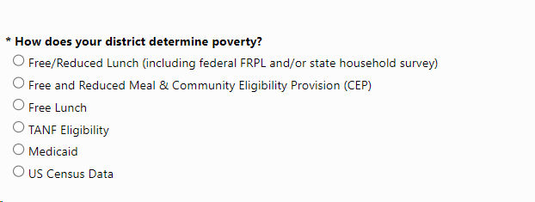
LEA Data Profile
Only includes a selection of how the LEA will determine poverty.
We draw this to your attention because you will need to still select the qualifying method, which is on a different page now (the School Ranking page).
This page does not inform the School Ranking page and is more of a tool for reviewers to know which data you plan to use.
Notes:
DC

Slide 39
Consolidated Application: School Ranking
Notes:
DC

Slide 40
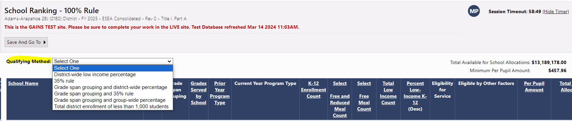
School Ranking
The name isn't the only thing that changed with the School Ranking page (previously known as the School Profile).
LEAs will need to select the "Qualifying Method" before designating schools as Title I:
Please note in the right-hand corner, above the chart, that there is that "Total Available for School Allocation." As mentioned previously, this number is pulled from the LEA Set-Asides page. This is a huge reason (and we can't emphasize it enough) why the LEA Set-Asides page NEEDS to be done and set before the School Ranking page. If something changes on the Set-Asides page, this will impact PPA and rank order.
Notes:
DC

Slide 41
School Ranking: Previous Application Similarities
Once the Qualifying Method is selected, the schools will sort accordingly like the old system.
The chart will list all the LEA's schools and provide the same information as the previous applications, including:
  School Name
  School Code
  Grade Span (known as Grades Served by School)
  Prior Year Program Type (NA, SW, TA)
  Current Year Program Type
  Enrollment Counts
  Free and Reduced Lunch Counts and Free Lunch Counts
  Percentage of Low-income Students
Notes:
DC

Slide 42
School Ranking: Previous Application Differences
The chart also includes some new information:
  Minimum Per Pupil Amount
  Eligibility for Services: if checked, the school is eligible to be served as a Title I school.
  Eligible by Other Factors: this allows LEAs to select if a school is a legacy school, if there is a schoolwide waiver for those below 40% or a prioritized high school.
  Per Pupil Amount: this used to be on a separate page
  Total Title I Allocation: This indicates how much each school should receive.
Notes:
DC

Slide 43
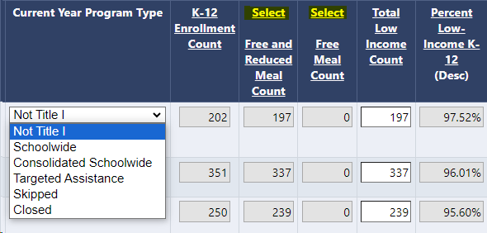
School Ranking: Program Type
LEAs will need to do a variety of tasks on this page once the Qualifying Method is selected.
Select Current Year Program Type:
  It automatically defaults to "Not Title I." LEAs can select from the dropdown if they wish to serve a school by selecting one of the following:
    Schoolwide
    Consolidated Schoolwide (NEW)
    Targeted Assistance
    Skipped (NEW)
    Closed (NEW)
Notes:
DC

Slide 44
School Ranking: FRL and FL Data
LEAs will click "Select" which is highlighted in the screenshot below, to either use Free and Reduced Meal Count or Free Meal Count data. This will change the Percentage of Low-income K-12.
If the LEA selects something other than FRL, FL on the LEA Profile page, or would like to utilize another point in time, the LEA will be able to edit both the "Total Low Income Count" column and the "K-12 Enrollment Count" column.
Notes:
DC Again, the LEA Data Profile doesn't talk to the School Ranking Page. But the LEA Data profile will be utilized if the LEA wishes to use another set of data that will need to be manually entered.

Slide 45
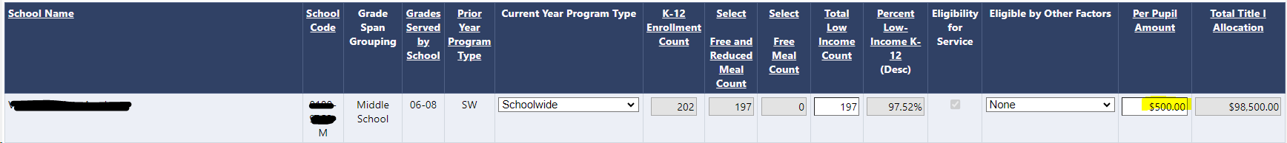
School Ranking: Per Pupil
Along with the PPA being on the School Ranking page and no longer the old Budget Locations page, users will enter the PPA amount.
  This is a different process as users would budget the amounts at each school and then check if the PPA was in rank order.
As the Current Year Program Type is selected, the Per Pupil Amount (PPA) box will open for LEAs to enter the amount.
Notes:
DC

Slide 46
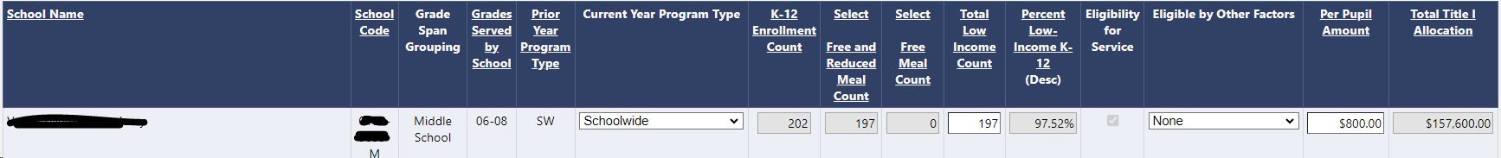
School Ranking: Per Pupil Change
Once a PPA is entered, the Total Title I Allocation for that school will be calculated.
This is the amount that should be budgeted for that specific school in the Title I budget.
You can see the number change in the screenshot as we increase the PPA from 500 to 800.
Please remember the Total Title I Allocation for the next slide:
$157,600
Notes:
DC

Slide 47

School Ranking: Remaining Allocation
In the example from the previous slide, we only had a PPA for one school of $800 dollars with an allocation for that school of $157,600.
At the bottom of the School Ranking page, you will see that the application is tracking how much you have allocated and how much you have remaining.
So, as you continue to add PPAs for your schools, you will be able to track totals at the very bottom of the page.
Notes:
DC

Slide 48
Consolidated Application: Budget
Notes:
JH

Slide 49
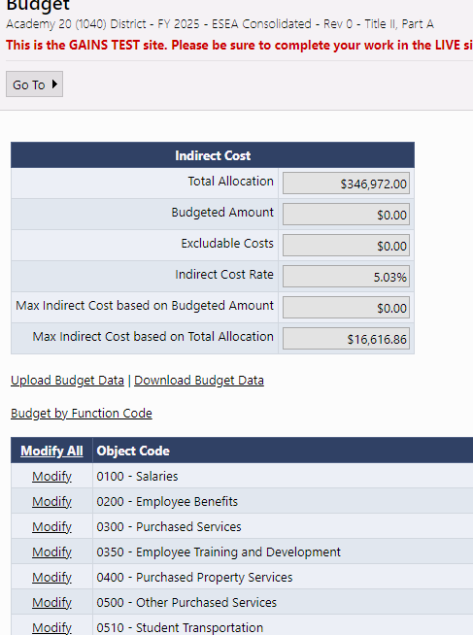
Budget Pages
Budgets pages will appear in each Title program section, as applicable.
Indirect Cost table will show Total Allocation, ICR%, and Max Indirect based on Total Allocation
As budget line items are added, the table will calculate Max Indirect based on Budgeted Amount, Budgeted Amount, and any Excludable Costs.
To open any Budget to add line items, click "Modify All"
Notes:
JH

Slide 50
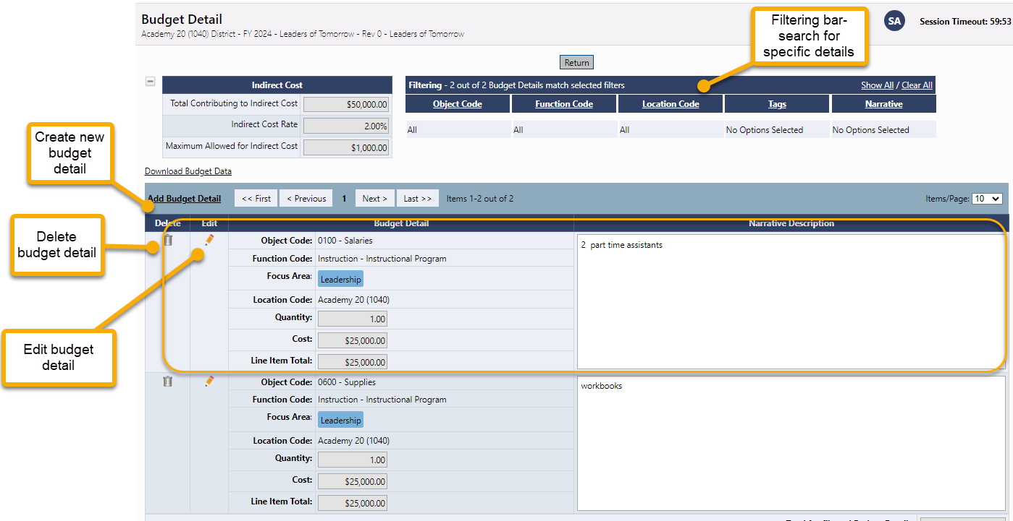
Budget Detail Page
Click the Add Budget Detail link to create a new budget line entry.
On this screen, you can also edit or delete existing budget details line items.
Use the filtering bar at the top of the page to find a group of expenditures or a specific detail.
Notes:
JH

Slide 51
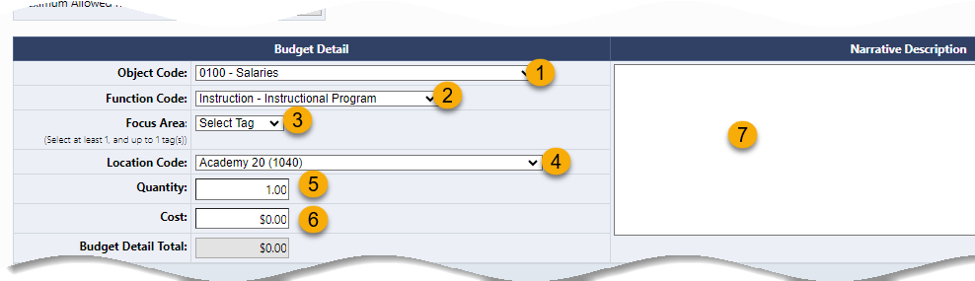
Creating a Budget Detail Entry
Select the applicable Object Code from drop-down.
Select applicable Function Code from drop-down.
Tags can identify additional attributes of a budget detail item and are used for filtering and reporting. Tags vary by grant and may not be an option in certain programs.
Location Code will default to the district location, but users will be able to select all the school level locations.
Entering a number in the quantity field multiplies the cost field (but is usually left at 1.00).
Enter the Cost. (If the quantity is 1.00, enter the total cost.)
Enter the narrative description for the item providing any necessary context for the budget line. This is a required element.
Click Create when finished adding the item or click Update if you are editing the item.
Notes:
JH

Slide 52
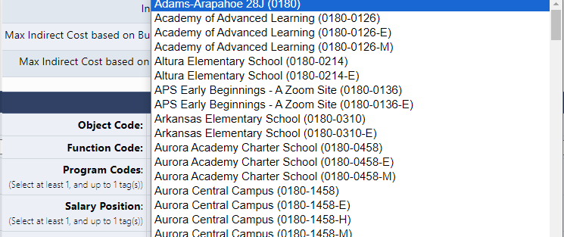
Budget Detail: Locations Dropdown
The Location Code is unique because it is going to list all schools within the LEA as E, M, H but also as a general school (not broken out by gradespan).
  This is because the system is setup for grants across the department that do not breakout funding by gradespan.
  It is imperative that Consolidated Application users select the gradespan for each school level activity. The School Ranking page is checking the allocation for that school based on the gradespan.
  If a general school location is selected, you will get a validation error that the funds haven't been budgeted to the school correctly.
General School
Gradespan specific
Notes:
JH

Slide 53
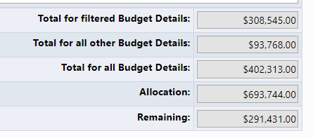
Completing the Budget
Continue creating Line Items until the “Total for all Budget Details” equals the Allocation.
The “Total for filtered Budget Details” field displays the total for details if a filter is applied.
The “Total for all Budget Details” field shows the current total of the budget.
The “Remaining” field reflects the amount of the Allocation still to be budgeted.
Notes:
JH

Slide 54
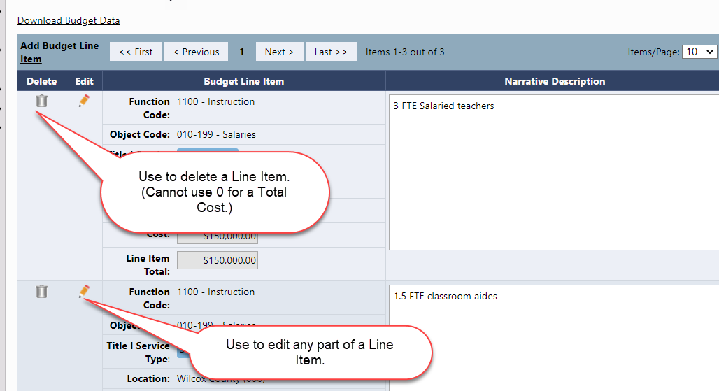
Edit Budget Details
Back on the Budget Detail page, to edit any part of a budget detail, click on the Pencil Icon in the Edit column, make your changes, and click Update.
To delete a budget detail, click on the Trash Can icon in the Delete column.
Notes:
JH

Slide 55
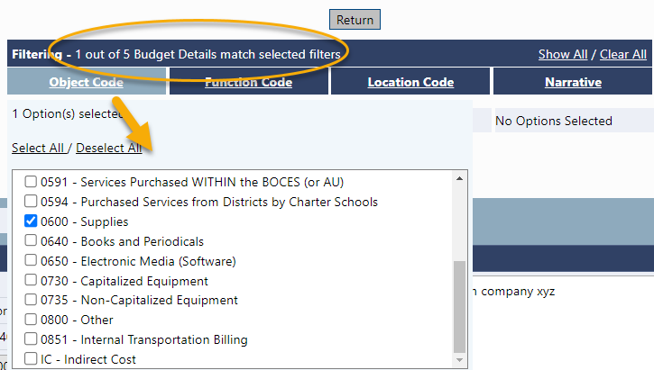
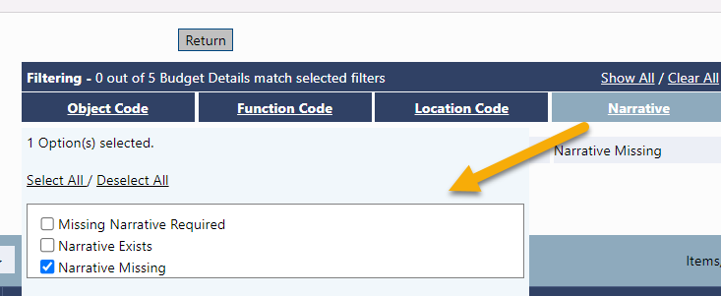
Filtering Budget Details
Also on the Budget Detail page, use the filtering bar to see specific groups of details; for example: the total of all supplies, finding missing narratives, seeing totals by location, etc.
Click a filter heading to see and select the available options.
Click on Show All to return to the view with all line items.
The header also indicates how many line items are present in the budget.
Notes:
JH

Slide 56
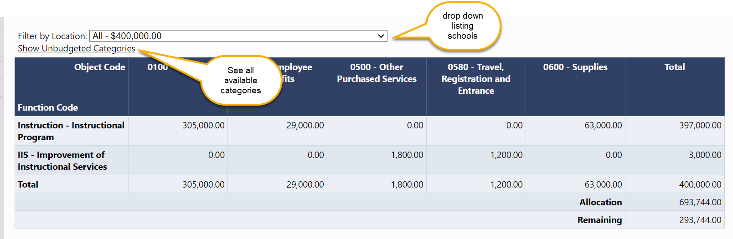
Budget Overview
The Budget Overview page is a non-editable grid view of the budgeted subtotals.
The overview can be filtered by locations and can show all possible function/object code combinations by selecting Show Unbudgeted Categories.
Notes:
JH

Slide 57
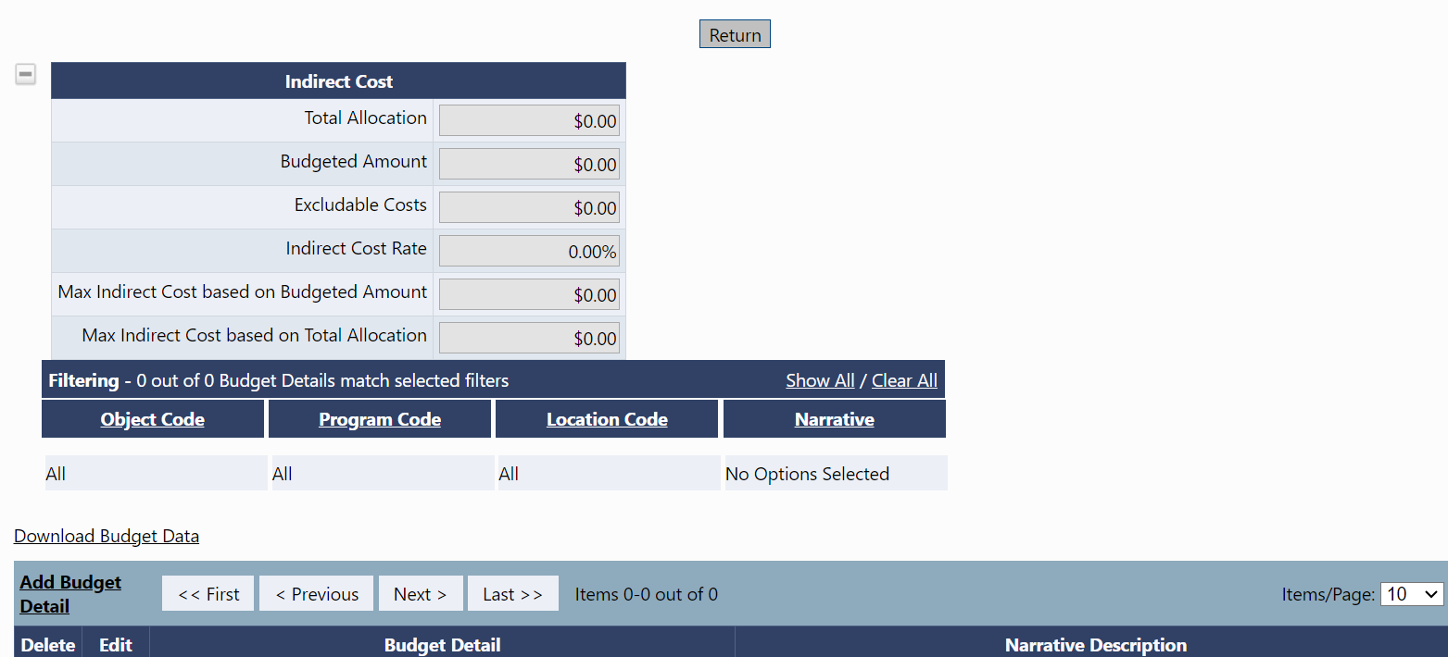
Downloading and Uploading Budgets
Excel budget files can be downloaded from and UPLOADED into GAINS.
We highly recommend building budgets in GAINS to start off.
Recommendation: Add at least ONE budget line before downloading the budget.
Notes:
JH

Slide 58

Brief Introduction: Excel Workbook Download
Create or update your budget in the same way you would in GAINS with each row = budget line item. Please note the following:
Action Column – Each row MUST have an associated Action command of either Create (new); Update (edit existing); or Delete (remove existing).
Workbook Tabs – Provide a list of Object Codes, Budget Tags, Function Codes, and available organizations that MUST be used to create the additional budget lines needed.
Excel Files are unique to each budget – Budgets have variations of tags and funding codes therefore each budget has a template unique to each program.
Notes:
JH

Slide 59
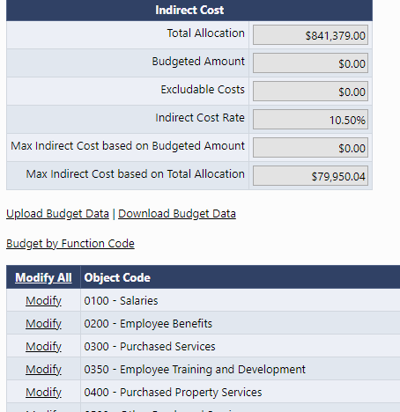
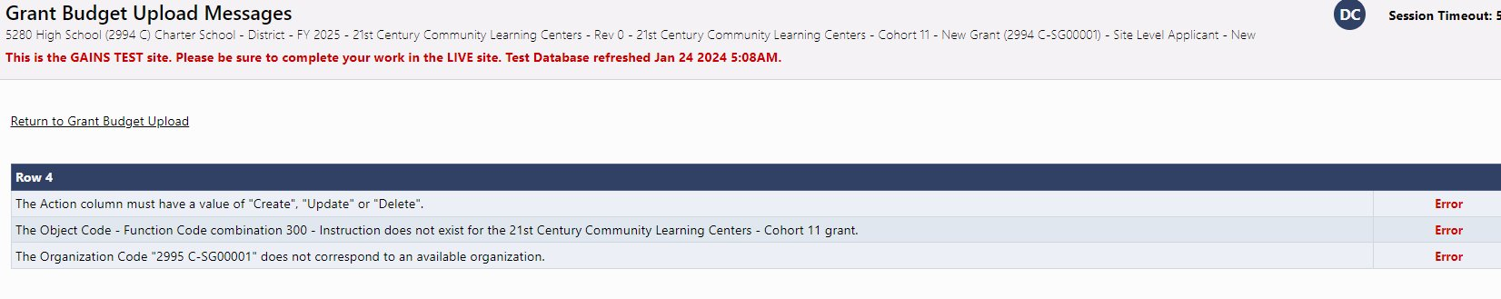
Uploading into GAINS
Once the excel budget is complete, upload the excel file from the Budget Detail page.
NOTE: The system will check that all rows have valid, minimum values. Uploads will not be completed and processed until all errors are resolved.
Notes:
JH

Slide 60
Budget Upload Additional Instructions and Resources
Coming soon!
For step-by-step instructions on how to complete and upload an excel budget into GAINS and resolve commons upload errors, please see our "Small Bites" guidance:
Recorded Training
Text Instructions Resource
Slide Deck with Screenshots
Notes:
JH

Slide 61
Questions Before Break and Walkthrough?
Notes:
JH

Slide 62
Break
Notes:
7 minutes

Slide 63

2024-2025 Consolidated Application Walk Through
Notes:
DC

Slide 64
BOCES Training
Notes:
DC

Slide 65
BOCES Agenda
BOCES Access to GAINS
Differences in BOCES versus LEA
  Title IX Requirements
  BOCES Narratives
  Title I, Part A
Notes:
DC

Slide 66
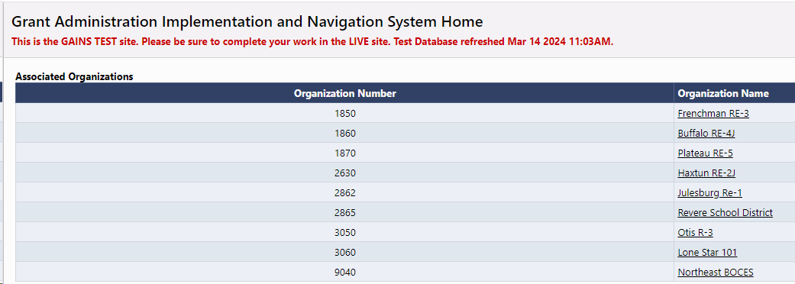
BOCES Application – Access
For BOCES that manage Title I, Part A - the BOCES users will need to be able to access the member district's application to complete various parts of Title I, Part A.
  However, the rest of the application will be completed in the BOCES application.
The Grants Program Administration (GPA) team will associate all the member district's application to the BOCES user based on the BOCES ESEA ARAC.
  When the BOCES user logins to the system, they will be able to see all member districts and their Consolidated Application.
Notes:
DC

Slide 67
BOCES Application – Title III Access
If you are a BOCES that only manages Title III and would like your member districts to have access to the BOCES application, please notify the GPA team at GAINS@cde.state.co.us.
  GPA will ensure these member districts only have "update" access and won't be able to submit the application. They will only be able to make edits.
Notes:
DC

Slide 68
BOCES Application – Differences from the LEA Application
BOCES will need to complete an additional section on the Contacts page to include a Title IX representative from each Member District.
BOCES narratives are the same questions but structured differently to capture a response from every member district.
Title I, Part A requires that the BOCES goes into the member district application to complete certain pages:
  LEA Set-Asides
  LEA Data Profile
  School Ranking
  Preschool Table
Notes:
DC

Slide 69
Title IX of the Education Amendments of 1972 - BOCES
Requires each district to have at least one Title IX coordinator to act as the “Lead”
This is the person that students and parents go to in order to file a Title IX (sex-based discrimination) complaint, such as:
  Sex-based harassment (includes gender-based harassment, sexual harassment, sexual violence)
  Lack of educational opportunities for girls (such as in STEM)
  Lack of equal opportunities for girls in athletics
  Discrimination to pregnant or parenting students
The Lead is the district level Title IX Coordinator that oversees school level Title IX Coordinators (if applicable)
Lead Title IX Coordinator's name and contact information should match the Lead Title IX contact posted on the district website.
Please include a phone number for the Title IX Coordinator!
For questions regarding school and district obligations under Title IX, contact:
Rebekah Ottenbreit
Phone: 303-907-9331
Email: Ottenbreit_R@cde.state.co.us
Notes:
DC
Heading—This is Title IX of the Education Amendments of 1972, NOT McKinney Vento, NOT ESEA or ESSA
Bullet 1—BOCES should provide the lead Title IX Coordinator for every one of their districts. The BOCES itself does not need a Title IX Coordinator unless they are directly providing classes or activities to K-12 students.
Bullet 2—This is usually a district level administrator such as the superintendent, an assistant superintendent, a Dean of Discipline or Director of Safety, someone who reports directly to the superintendent. This usually should not be the Homeless Liaison or a Title I teacher. Usually, when those folks are listed, it is because the person completing the Cons App was confused about which Title IX we are referencing.
Bullet 3—If a district has multiple Title IX Coordinators, the district Lead oversees school level Title IX Coordinators. School level Coordinators are usually school level administration such as a principal, AP, or Dean of Discipline.
Bullet 4—All districts are required to “prominently post” their non-discrimination statement and the Lead Title IX Coordinator’s name, office address, phone and email on their homepage. When the Title IX contact(s) submitted through Cons App differs from the Title IX Contact listed on the website, this is a problem.

Slide 70
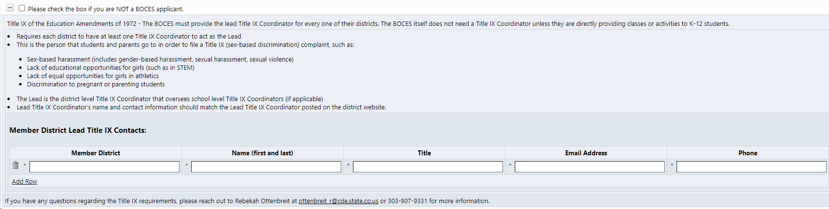
Title IX of the Education Amendments of 1972 – BOCES Section
The BOCES application will have a specific Title IX section which needs to be completed on the Contacts page.
Please be sure to enter a Title IX contact for each member district in the chart, utilizing the Add Row feature:
Notes:
DC
Heading—This is Title IX of the Education Amendments of 1972, NOT McKinney Vento, NOT ESEA or ESSA
Bullet 1—BOCES should provide the lead Title IX Coordinator for every one of their districts. The BOCES itself does not need a Title IX Coordinator unless they are directly providing classes or activities to K-12 students.
Bullet 2—This is usually a district level administrator such as the superintendent, an assistant superintendent, a Dean of Discipline or Director of Safety, someone who reports directly to the superintendent. This usually should not be the Homeless Liaison or a Title I teacher. Usually, when those folks are listed, it is because the person completing the Cons App was confused about which Title IX we are referencing.
Bullet 3—If a district has multiple Title IX Coordinators, the district Lead oversees school level Title IX Coordinators. School level Coordinators are usually school level administration such as a principal, AP, or Dean of Discipline.
Bullet 4—All districts are required to “prominently post” their non-discrimination statement and the Lead Title IX Coordinator’s name, office address, phone and email on their homepage. When the Title IX contact(s) submitted through Cons App differs from the Title IX Contact listed on the website, this is a problem.

Slide 71
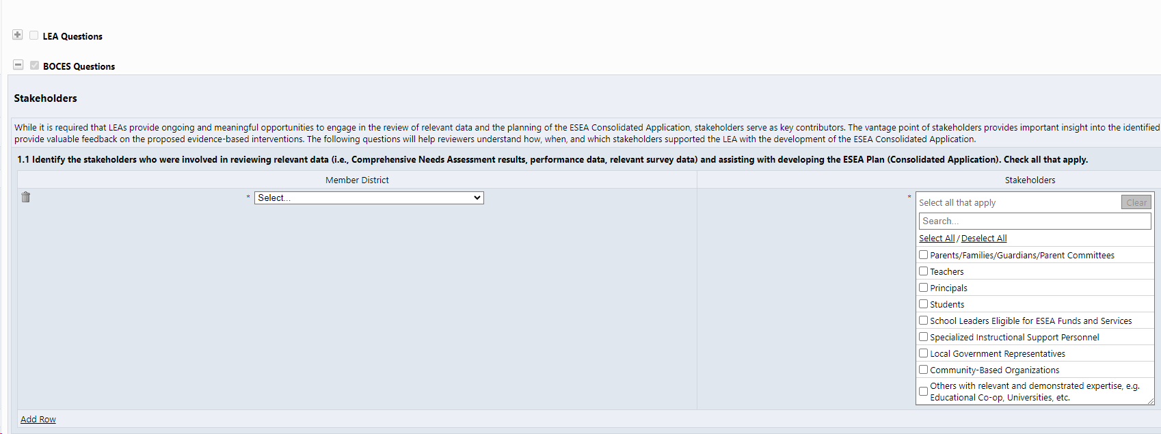
BOCES Application – Narratives
The application will only show the BOCES questions.
Each question will be in a chart where the BOCES can select the member district and provide the associated response.
The BOCES will have the option to "Add Row" and enter as many responses as necessary (one for each member district).
All narrative questions will be completed in the BOCES application.
Notes:
DC

Slide 72
BOCES Application – Title I, Part A
The biggest difference for the BOCES application is that the BOCES won't be able to complete the LEA Set-Asides page, LEA Data Profile, School Ranking or Preschool Table within the BOCES application.
All these pages must be completed within the Member District application.
  If you are a BOCES user and you don't see all your member districts, please let GPA know at GAINS@cde.state.co.us.
However, once in the member district's application, each page functions the same.
Notes:
DC

Slide 73
BOCES Application – Title I, Part A Section
The BOCES user will go into each application and fill out the necessary pages under Title I, Part A
  LEA Set-Asides
  LEA Data Profile
  School Ranking
  Preschool Table
Once these pages are complete and the School Allocation is known, the BOCES user will jump back into the BOCES application and complete the Title I, Part A narratives, as well as the budget.
The BOCES application won't be able to validate whether the schools are in rank order. CDE reviewers will be checking this once it is submitted.
Notes:
DC

Slide 74
2024-2025 BOCES Consolidated Application Walk Through
Notes:
DC

Slide 75
BOCES Questions?
Notes:
DC

Slide 76
Additional Support
Notes:
Patty to end of presentation

Slide 77
Upcoming Regional Network Meetings and Consolidated Application Training
Spring RNMs
The Federal Programs and Supports Unit (FPSU) invites you to our upcoming Regional Network Meetings (RNM). The purpose of these RNMs is to provide an overview of the 2023-2024 Consolidated Application for ESEA funds and to offer assistance in the creation of your LEA’s Consolidated Application.
The in-person regional consolidated application work sessions will provide an opportunity for LEAs to workshop their application with individualized support from ESEA specialists. LEAs are welcome to attend any work session, regardless of region. Please contact Rachel Echsner with any questions.
Metro Region: May 21st from 12-3:00pm at Daniels Fund. Register HERE
SE/Pikes Peak Region: May 30th from 10am-1:00pm at the Pikes Peak BOCES. Register HERE
NW/WC Region: May 14th from 10am-1:00pm at the Technical College of the Rockies. Register HERE
NW/WC Region: May 15th from 11am-2:00pm at the Moffat Board Room. Register HERE
SW Region: May 15th from 12:30-3:30pm at the Alamosa School District Building. Register HERE
NC/NE Region: May 15 from 12:30-3:30pm at the Greeley Administration Building. Register HERE
SW Region: May 16th from 9am-12:00pm at the Impact Center. Register HERE

Slide 78

Technical Assistance and GAINS Resources
GAINS Help Desk Ticket
GAINS CDE Resources
GAINS Training Webpage
Catch up on past trainings provided by CDE!
Ask for help and indicate a time that works best for you through this ticketing system!
Any additional resources will be posted in GAINS!
Reach out to us via email!
GAINS@cde.state.co.us
Notes:
PG

Slide 79
Consolidated Application Support from the Grants Program Administration Office
GPA Staff | Program Expertise | E-mail | Regional Support
DeLilah Collins | Director of Grants Program Administration Office | Collins_D@cde.state.co.us | Northeast/North Central, Metro
Jessica Hollingshead | Operations Supervisor | Hollingshead_J@cde.state.co.us | Pikes Peak, Metro
Megan Allen Winicki | Grants Management Specialist | Allen_M@cde.state.co.us | Northwest, Metro, Southeast and Southwest
Kim Burnham | Competitive Grants and Awards Supervisor | Burnham_K@cde.state.co.us
Patty Gleason | Competitive Grants and Awards Senior Consultant | Gleason_P@cde.state.co.us
If you are from the Metro Region, please include all three individuals on your outreach - DeLilah, Jessica, and Megan

Slide 80
Federal Programs and Support Unit
Federal Programs & Supports (ESEA/ESSER Program Supports)
Nazie Mohajeri-Nelson, Executive Director of Federal Programs & Supports Unit Program Specialists Program Implementation Supervisor: Laura Meushaw Program Implementation Coordinator: Christina Adeboye Sullivan Program Monitoring Supervisor: Tammy Giessinger ESEA/ESSER Monitoring Coordinator: Kristin Crumley Program Effectiveness Supervisor: Tina Negley Program Evaluation & Research Coordinator: Mary Shen ESEA Programs Specialists and ESEA Regional Contacts (assigned by district) Title I: Laura Meushaw, Evita Byrd, Rachel Echsner, Kim Boylan Title II: Rachel Echsner, Sue Miller-Curley Title III: Rachel Temple, Kim Boylan Title IV & Stronger Connections Grant: Nathan Hickman, Evita Byrd Title V: Christina Adeboye-Sullivan, Rachel Echsner ESSER Program Specialists Jonathan Schelke Kim Boylan Kriselda Craven Nadine Penn ESEA and ESSER Data and Reporting Specialists Mackenzie Owens (ESSER) Melissa Chaffin (ESEA) Jerry Ring (ESEA)

Slide 81
Consolidated Application Support from the Grants Fiscal Office
Grants Fiscal Staff | Program Expertise | E-mail
Jennifer Austin | Director of Grants Fiscal | Austin_J@cde.state.co.us
Robert Hawkins | Grants Fiscal Analyst | Hawkins_R@cde.state.co.us
Steven Kaleda | Grants Fiscal Analyst | Kaleda_S@cde.state.co.us

Slide 82
Final Questions?

Slide 83
Contact us with Questions!
If reviewing this slide deck after the live presentation, feel free to contact your Regional Contact, the Grants Program Administration Office, or the Grants Fiscal Office. Questions can also be sent to consolidatedapplications@cde.state.co.us

