Slide 1
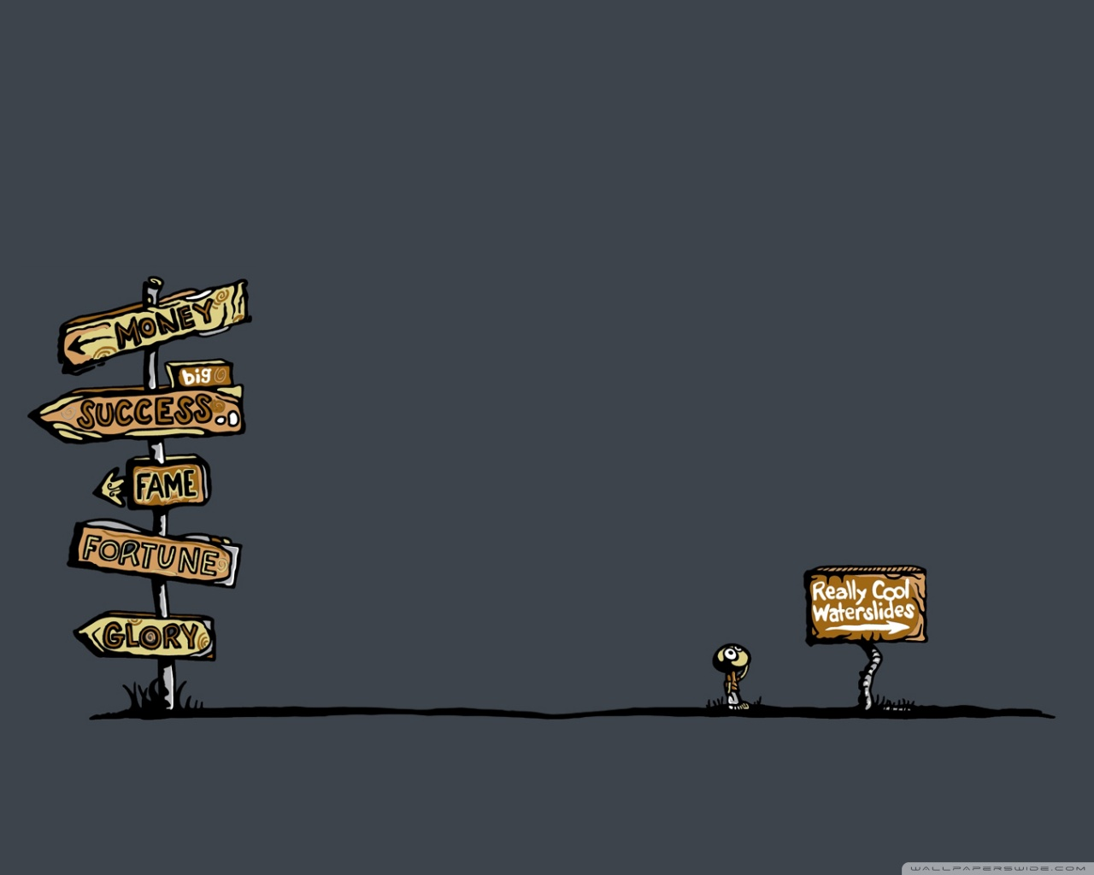
Key Messages and Talking Points
Individual Career and Academic Plans

Slide 2
Tonight we will discuss
Individual Career and Academic Plans
  What they are
  What they entail
  Why we should do them
  How we do them

Slide 3
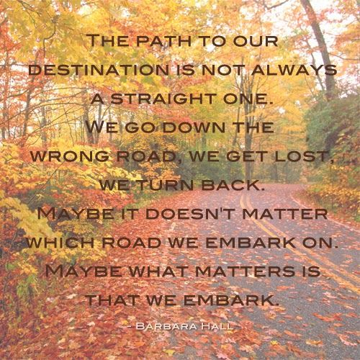

How did you get to where you are today?
First in family to graduate high school
Graduated high school
Went to college
Dropped Out of High School
Someone told me I was good enough
Dropped out of college
First in family to graduate from college
Had someone believe in me
Got married
Had a child
Went back to school
Had someone tell me I would never succeed in life
Failed
Picked myself up
Got Divorced
Got a job
Started my career
Changed jobs
Changed Majors
Got remarried
Had another child
Changed Majors again
Bought a house
Faced a tragedy

Slide 4
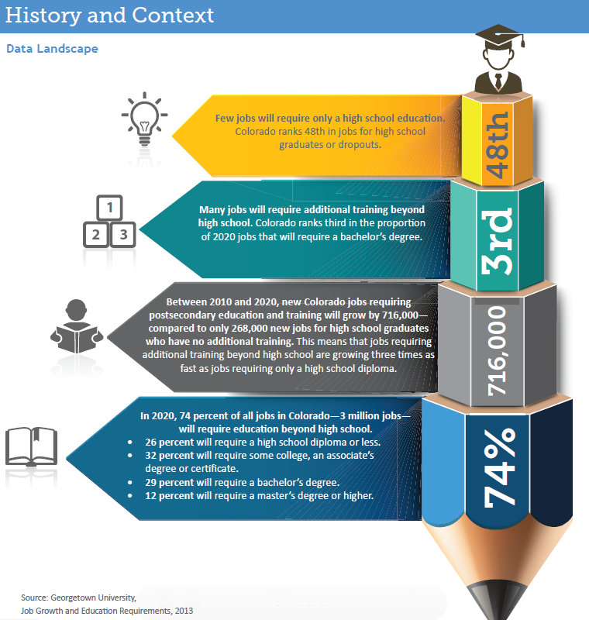
Life after high school is different than what it used to be…especially in CO

Slide 5
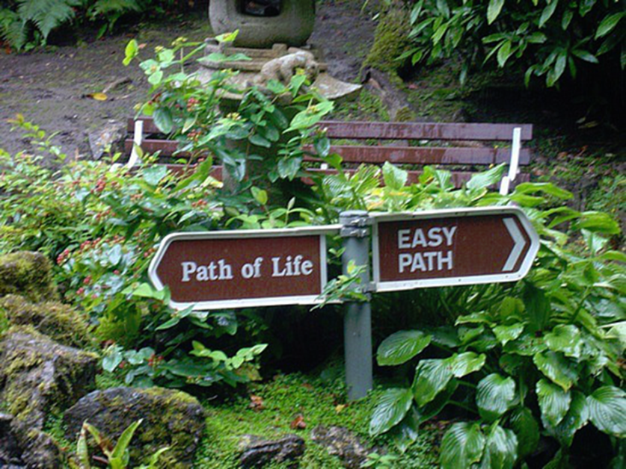
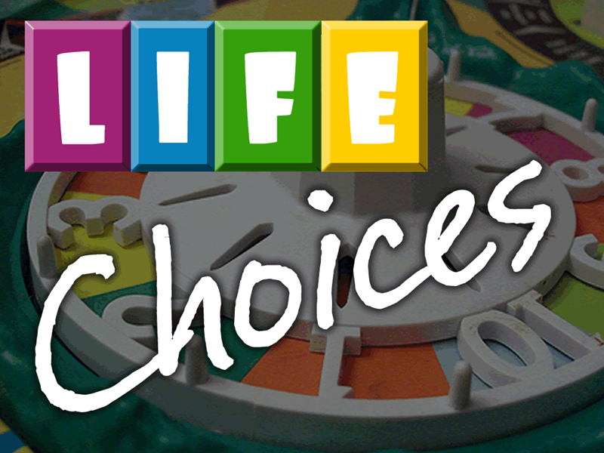
We can’t let our kids just leave their life up to chance…

Slide 6

ICAPs can help…
Students have a chance to look inside ─ to determine their interests and passions and outside ─ to explore and experience career opportunities.
ICAP helps students imagine a future career and helps them design the way to get there.
With greater knowledge, students can imagine and then craft their individual career pathway to success.

Slide 7


ICAP in a Nutshell
So what is an ICAP?
ICAP is a multi-year process (beginning in 9th grade) that intentionally guides students as they explore CAREER, ACADEMIC and POSTSECONDARY OPPORTUNITIES.
With the support of adults, students develop the awareness, knowledge, attitudes and skills to create their own meaningful and PoWeRful pathways to be career and college ready.

Slide 8
ICAPs should include, but not be limited to:
Personal Reflections and
Self-Guided Inquiry
School Related Documentation
career and college interest surveys,
written postsecondary and workforce goals,
  intermediate benchmarks and data reflecting progress toward those goals,
activities that establish connections between school-based instruction and the world of work,
experiences in service learning and/or work environments,
scores on assessments,
an intentional sequence of courses that reflect progress toward the postsecondary goal, academic progress,
college application(s), a resume or alternative work-based applications
an understanding of the financial impact of life after high school, including an education.

Slide 9

When students take the initiative to complete a meaningful ICAP…
they find out which pathways fit their learning styles and their unique talents,
Which careers ignite their imagination
what kind of training and academic experiences will prepare them for in-demand jobs now and for jobs that may not exist when they graduate from high school.

Slide 10

The result is that they:
Find Relevance to High School:
Connect the relevance of education to future aspirations
Are connected to their college and career goals
Establish better communication and relational connections between school and home
Are More Motivated to Attend School and Stay Engaged:
Become confident learners who can actively set goals
Make secondary and postsecondary course plans to pursue career and life goals
Select a pathway that strategically aligns with self-defined career, college, and life goals
Are able to articulate their transferable skills and apply knowledge about how their actions today connect with their goals
Can Transfer Skills to Real Life:
Have access to quality career guidance activities
Understand and demonstrate self-exploration, career exploration and career planning and management

Slide 11




Slide 12

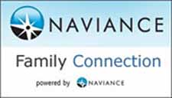
So how do we get started?

